Slide 1

Yik Yak
It’s not all bad;
but, yes there are some bad parts
& some actions we can take
Dr. Paul Leighton
Presented at the 2015 Women's Center Professionals Directors Meeting, Eastern Michigan University
Notes:
Leighton, Paul. 2015. Yik Yak: It’s not all bad; but, yes there are some bad parts & some actions we can take.
http://www.paulsjusticeblog.com/2015/07/yikyak_harassment_activism.php

Slide 2

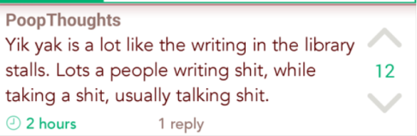
Yik Yak Basics
Anonymous message board
Pulls posts from 1.5 miles around
Time-limited / “ephemeral”
200 characters
Upvote/downvote [-5 means removal]
Report offensive content for deletion
Screenshot from EMU Yik Yak, March 2015.
Notes:
Leighton, Paul. 2015. Yik Yak: It’s not all bad; but, yes there are some bad parts & some actions we can take.
http://www.paulsjusticeblog.com/2015/07/yikyak_harassment_activism.php

Slide 3
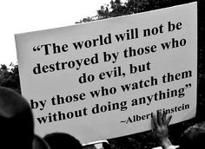
Oppression & ephemeral, interactive public performance
Some harassment reflects social inequalities
Response shapes whether inequalities are recreated or resisted
Public acts of oppression
implicate spectators,
who can encourage,
discourage or be
silent (= consent)
Notes:
Leighton, Paul. 2015. Yik Yak: It’s not all bad; but, yes there are some bad parts & some actions we can take.
http://www.paulsjusticeblog.com/2015/07/yikyak_harassment_activism.php

Slide 4

Background
Honor’s College Students
  Gender-based slurs (b****, c***)
  Directed at female faculty
  While class was going on
  Sexual harassment upvoted by others
    See “A New Faculty Challenge: Fending Off Abuse on Yik Yak” Chronicle of Higher Education, EMUtalk.org
    Who Spewed that Abuse? Anonymous Yik Yak App Isn’t Telling New York Times
Wrongful behavior has come to define what Yik Yak is about
Notes:
Leighton, Paul. 2015. Yik Yak: It’s not all bad; but, yes there are some bad parts & some actions we can take.
http://www.paulsjusticeblog.com/2015/07/yikyak_harassment_activism.php

Slide 5
What happens when you post this?
Upvote/downvote count.
But do not know if it is
+10 and -3
Or
+30 and -23
Screenshot from EMU Yik Yak, March 2015.
Notes:
Leighton, Paul. 2015. Yik Yak: It’s not all bad; but, yes there are some bad parts & some actions we can take.
http://www.paulsjusticeblog.com/2015/07/yikyak_harassment_activism.php

Slide 6

While there are homophobic posts and comments…
Heterosexual privilege includes the expectation that one’s sexuality will be accepted by family, friends, co-workers and neighbors. So is belonging to the religion of your choice and knowing that your sexuality will not be denounced by its leaders.
Screenshot from EMU Yik Yak, March 2015.
Notes:
Leighton, Paul. 2015. Yik Yak: It’s not all bad; but, yes there are some bad parts & some actions we can take.
http://www.paulsjusticeblog.com/2015/07/yikyak_harassment_activism.php

Slide 7
What happens when you post this?
Screenshot from EMU Yik Yak, March 2015.
Notes:
Leighton, Paul. 2015. Yik Yak: It’s not all bad; but, yes there are some bad parts & some actions we can take.
http://www.paulsjusticeblog.com/2015/07/yikyak_harassment_activism.php

Slide 8
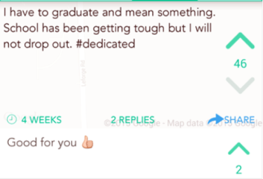
Social support & affirmation also happen
Screenshots from EMU Yik Yak,
March 2015.
Notes:
Leighton, Paul. 2015. Yik Yak: It’s not all bad; but, yes there are some bad parts & some actions we can take.
http://www.paulsjusticeblog.com/2015/07/yikyak_harassment_activism.php

Slide 9
“more mundane than offensive”
“Most people are just chatting about homework, the weather, their desperation to get laid, and the timing of their bowel movements.”
  -Amanda Hess,
  The Upside of YikYak. Slate, 10 March 2015
Screenshot from EMU YikYak, March 2015.
Notes:
Leighton, Paul. 2015. Yik Yak: It’s not all bad; but, yes there are some bad parts & some actions we can take.
http://www.paulsjusticeblog.com/2015/07/yikyak_harassment_activism.php

Slide 10
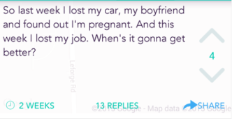

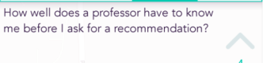
Why we need to take Yik Yak seriously
Screenshots from EMU YikYak, March 2015. With several hundred posts a day, these are not necessarily representative
Notes:
Leighton, Paul. 2015. Yik Yak: It’s not all bad; but, yes there are some bad parts & some actions we can take.
http://www.paulsjusticeblog.com/2015/07/yikyak_harassment_activism.php

Slide 11
Not mundane, not offensive
Case 1: Force girls… (Public Service Announcement)
The upvote indicates approval by Yik Yak users.
They may or may not be a representative sample of EMU students in general.
Screenshot from EMU YikYak, March 2015.
Notes:
Leighton, Paul. 2015. Yik Yak: It’s not all bad; but, yes there are some bad parts & some actions we can take.
http://www.paulsjusticeblog.com/2015/07/yikyak_harassment_activism.php

Slide 12
Case 2: Trying not to cry…
At -5, the post is deleted*
Next downvote deletes this because of earlier community disapproval
Would you do it?
* -5 on absolute scale, not just 5 downvotes [if 20 upvotes, then 25 downvotes to delete]
Notes:
Leighton, Paul. 2015. Yik Yak: It’s not all bad; but, yes there are some bad parts & some actions we can take.
http://www.paulsjusticeblog.com/2015/07/yikyak_harassment_activism.php

Slide 13
Case 2: He scares me…
Screenshot from EMU YikYak, 2015.
Notes:
Leighton, Paul. 2015. Yik Yak: It’s not all bad; but, yes there are some bad parts & some actions we can take.
http://www.paulsjusticeblog.com/2015/07/yikyak_harassment_activism.php

Slide 14
Case 3: I’m pregnant…
Good bystander intervention!
But…
Screenshot from EMU YikYak, 2015.

Slide 15
Case 3: I’m pregnant [2] …
OMG = Oh my God, so OMFG…
Other bystanders raise their voice
End an offensive post by being 5th downvote
Flag for deletion by Yik Yak administration
Screenshot from EMU YikYak, 2015.

Slide 16
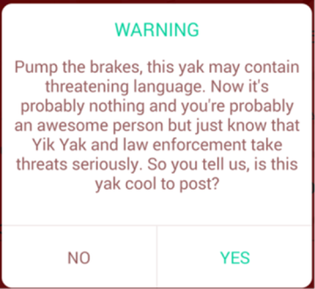
Safeguards 1
Certain words (“gun” in this case) trigger this warning
Is the list of trigger words gender sensitive?
Test for yourself, publicize results, make recommendations, publicize/pressure

Slide 17
Safeguards 2
Downvoting a post triggered this warning
Is the follow-up of removing offensive posts gender sensitive?
Test for yourself, publicize results, make recommendations, publicize/pressure

Slide 18
Conclusions 1
Screenshots from EMU Yik Yak,
June 2015
Given self-expression on Yik Yak, banning it is an act of bullying
Notes:
Add sceenshot of wating to get good grades and thumb’s up.
Occupy from star lecture

Slide 19
Conclusions 2
Larger problems of bullying reflected on Yik Yak (as well as altruism)
Same anonymity that makes it easy to harass also emboldens bystanders to intervene
How to promote positivity and effective bystander interventions, esp for harassment that reinforces oppression?
Notes:
Leighton, Paul. 2015. Yik Yak: It’s not all bad; but, yes there are some bad parts & some actions we can take.
http://www.paulsjusticeblog.com/2015/07/yikyak_harassment_activism.php

Slide 20
Conclusions 3
OCCUPY
Screenshots from EMU Yik Yak,
June 2015
Notes:
Leighton, Paul. 2015. Yik Yak: It’s not all bad; but, yes there are some bad parts & some actions we can take.
http://www.paulsjusticeblog.com/2015/07/yikyak_harassment_activism.php

Slide 21

Action Steps
Dynamics of Yik Yak reflect ‘the Herd,’ so recruit good people to participate
Supporters to
  Monitor
  Quick response to downvote offensive posts & upvote positive ones
  Provide information, referrals, support
Work to enhance ability to be articulate in 200 characters
Test Yik Yak safeguards, recommend improvements, publicize/pressure
Notes:
Leighton, Paul. 2015. Yik Yak: It’s not all bad; but, yes there are some bad parts & some actions we can take.
http://www.paulsjusticeblog.com/2015/07/yikyak_harassment_activism.php

Slide 22
Dr. Paul Leighton is a professor in the Department of Sociology, Anthropology & Criminology at Eastern Michigan University. He has been teaching a graduate level course on domestic violence and sexual assault for the 17 years he has been at EMU. Leighton served six years, including two as president, on the board of SafeHouseCenter.org. He is a co-author of Class, Race, Gender & Crime, 4th ed.
More information about him is available on his website,
http://paulsjusticepage.com/paul/pauls-cv.htm
His DV and SA class
http://paulsjusticepage.com/emu/crm550.htm
This presentation is a revised and expanded version of one originally presented at a 2015 ACE-EMU panel, Workplace Bullying, Harassment, Stress and You, as part of Women's History Month programming.
Notes:
Leighton, Paul. 2015. Yik Yak: It’s not all bad; but, yes there are some bad parts & some actions we can take.
http://www.paulsjusticeblog.com/2015/07/yikyak_harassment_activism.php

