Slide 1
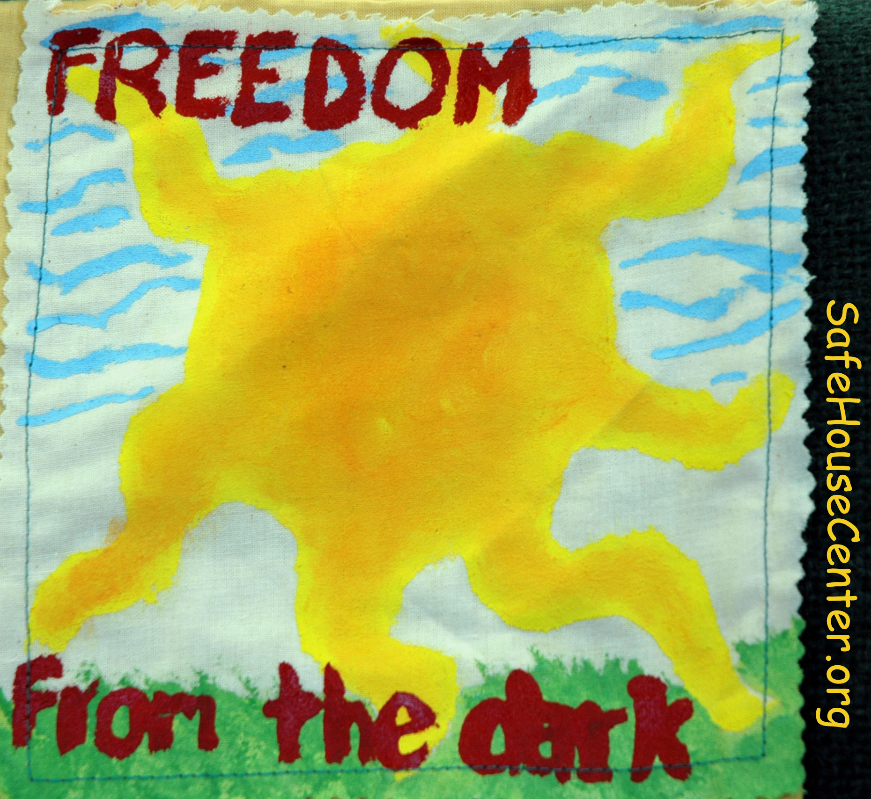
Understanding Domestic Violence:
Why you should care,
what you should know and how to help
Dr. Paul Leighton
Professor of Criminology, Eastern Michigan University and former board member of SafeHouseCenter.org
http://www.paulsjusticepage.com/
Notes:
Leighton, Paul. 2014. Understanding Domestic Violence. Available, http://paulsjusticepage.com/paul/pauls-cv.htm.

Slide 2
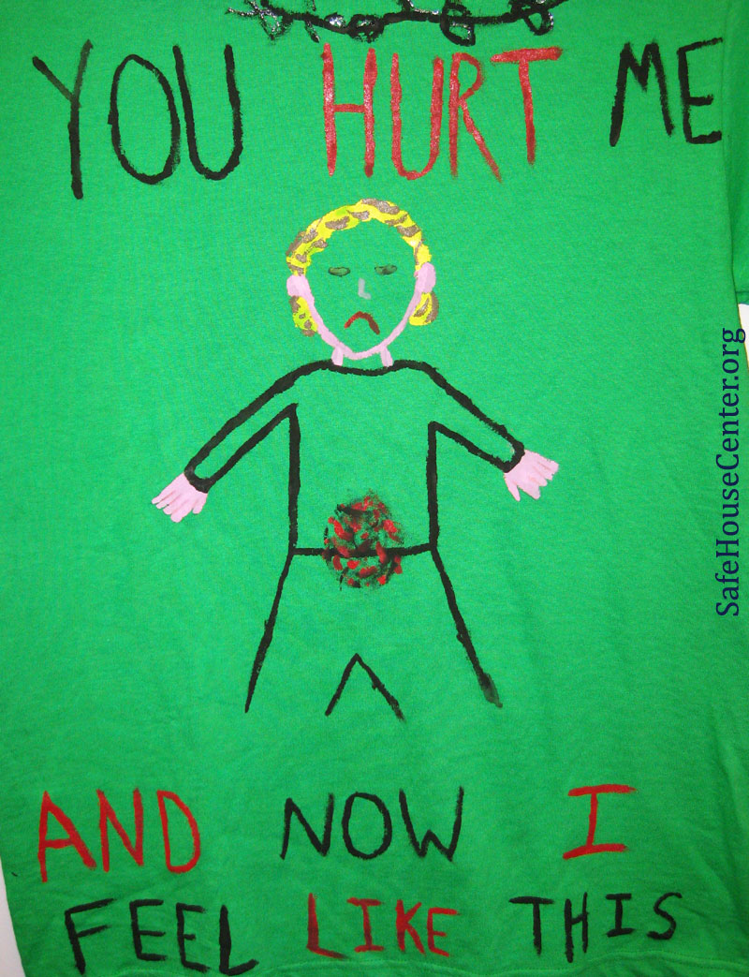
What should you know?
Why should you care?
What can you do to help?
Notes:
Leighton, Paul. 2014. Understanding Domestic Violence. Available, http://paulsjusticepage.com/paul/pauls-cv.htm.

Slide 3
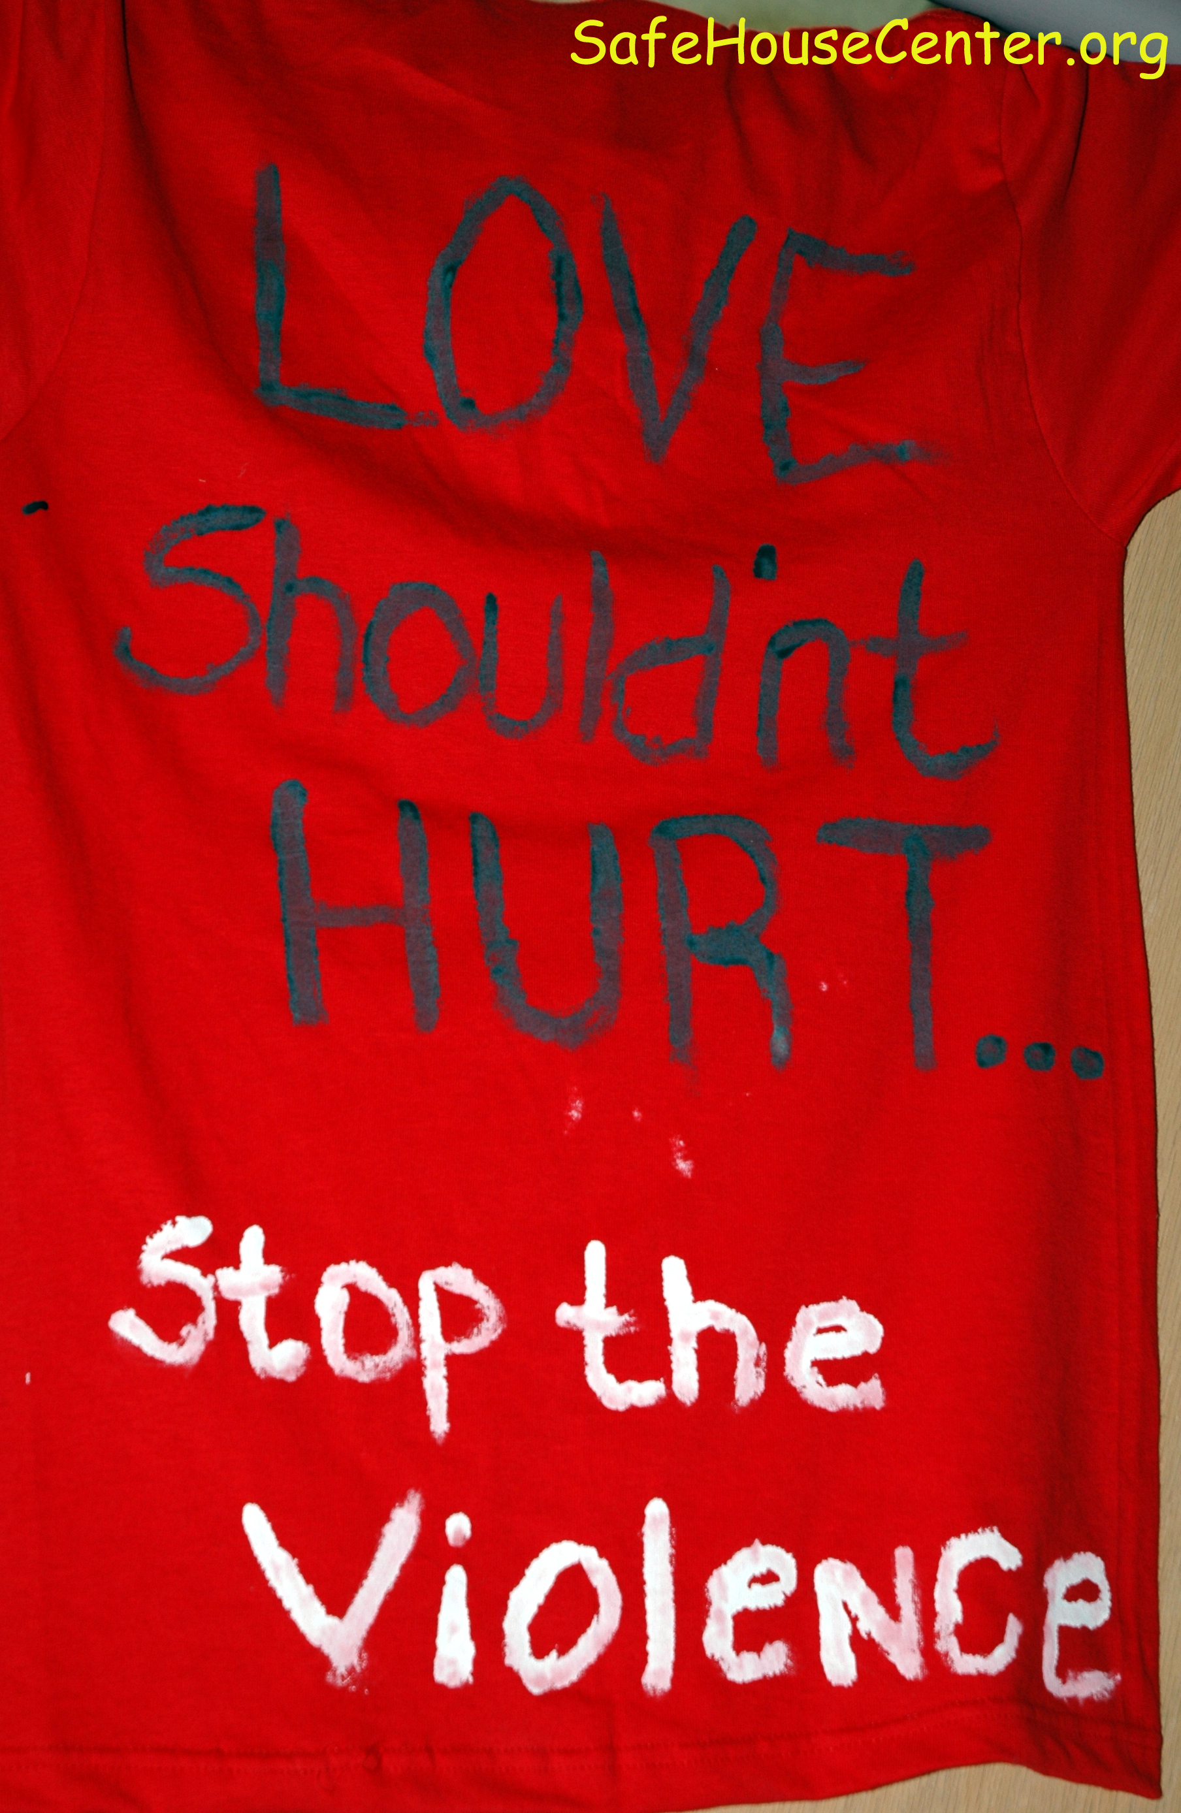
Know: DV definition
Intimate partner violence is a pattern of assaultive and coercive behaviors that may include inflicted physical injury, psychological abuse, sexual assault, progressive social isolation, stalking, deprivation, intimidation and threats. These behaviors are perpetrated by someone who is, was, or wishes to be involved in an intimate or dating relationship with an adult or adolescent, and are aimed at establishing control by one partner over the other.
Family Violence Prevention Fund. National Consensus Guidelines on Identifying and Responding to Domestic Violence Victimization in Health Care Settings.
http://www.endabuse.org/userfiles/file/Consensus.pdf
Notes:
Leighton, Paul. 2014. Understanding Domestic Violence. Available, http://paulsjusticepage.com/paul/pauls-cv.htm.

Slide 4

Know: Key Aspects
Pattern of Coercive Behavior
Notes:
Leighton, Paul. 2014. Understanding Domestic Violence. Available, http://paulsjusticepage.com/paul/pauls-cv.htm.

Slide 5
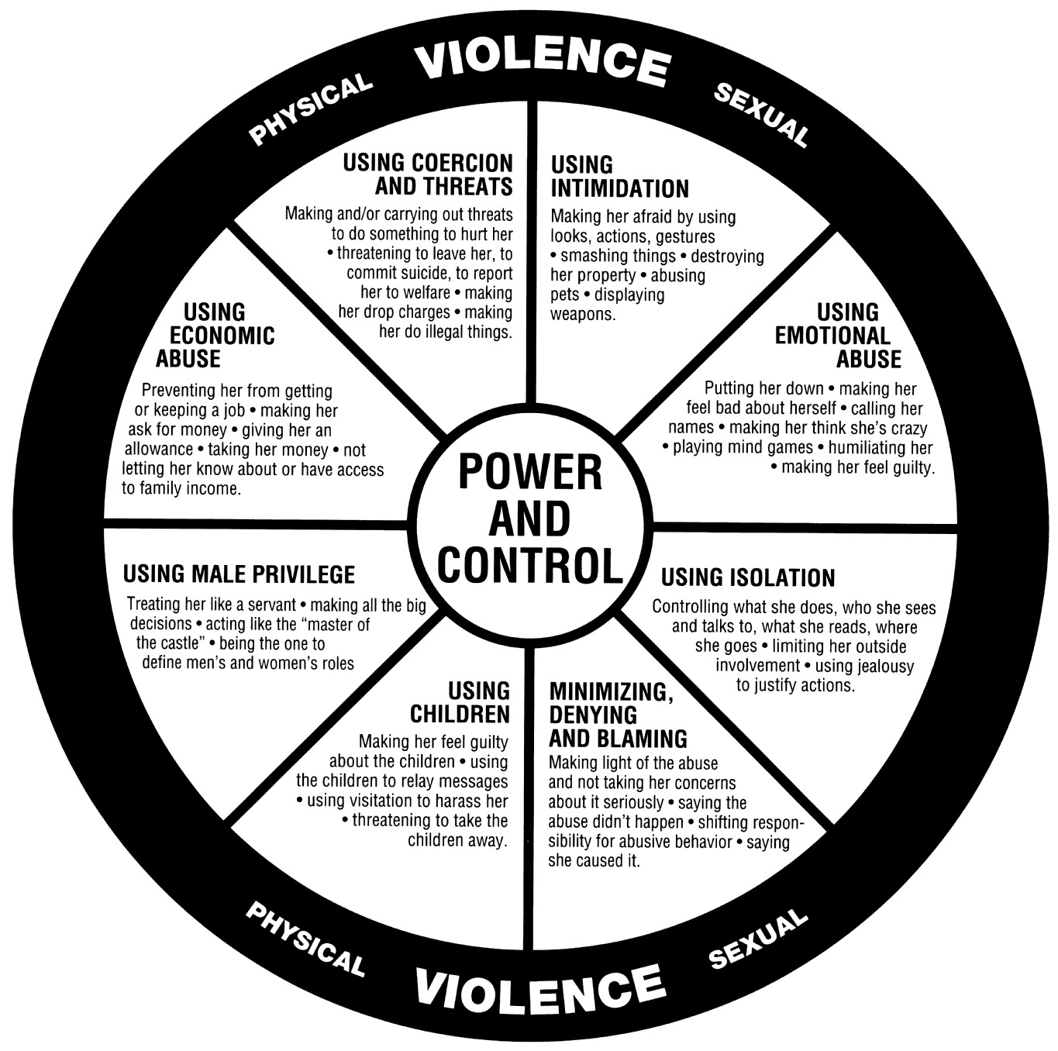
Know: Power and Control Wheel
http://www.ncdsv.org/publications_wheel.html
Notes:
Leighton, Paul. 2014. Understanding Domestic Violence. Available, http://paulsjusticepage.com/paul/pauls-cv.htm.

Slide 6
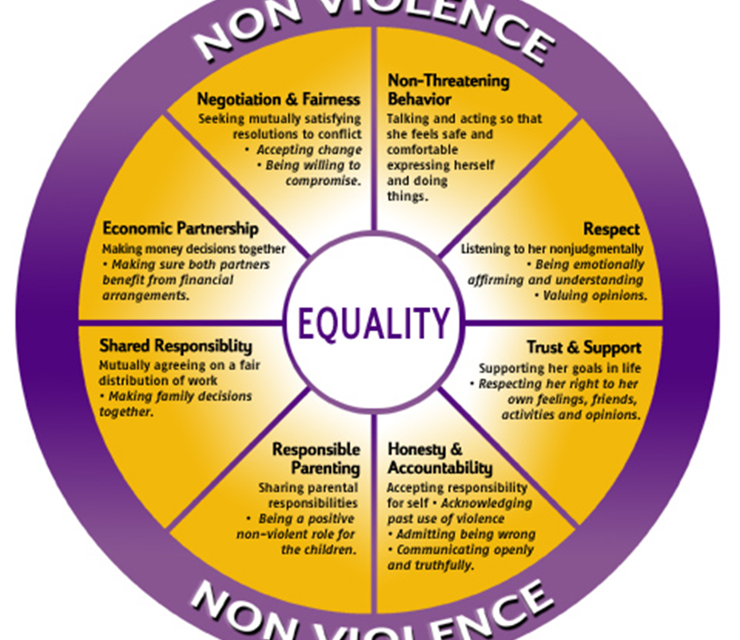
Think About: Equality Wheel
http://www.ncdsv.org/publications_wheel.html
Notes:
Leighton, Paul. 2014. Understanding Domestic Violence. Available, http://paulsjusticepage.com/paul/pauls-cv.htm.

Slide 7
Know: DV can happen to
Generally MEN’S VIOLENCE AGAISNT WOMEN
Among violent crimes against a spouse, 86.1% of the offenders were male; against a boyfriend or girlfriend, 82.4%*
Teens
Senior citizens
All classes
All races
All religions
Gays/lesbians
Men in heterosexual relationships
Bureau of Justice Statistics, Family Violence Statistics (2005, NCJ 207846) http://bjs.ojp.usdoj.gov/content/pub/pdf/fvs.pdf
Notes:
Leighton, Paul. 2014. Understanding Domestic Violence. Available, http://paulsjusticepage.com/paul/pauls-cv.htm.

Slide 8
Know: Sexual Assault
Any sexual act committed without consent, through force, coercion or intimidation and/or when an individual is unable to freely and knowingly give consent
Wives can be raped by husbands
According to Michigan law, people who are drugged, incapacitated or under the age of 16 are deemed unable to give consent.
Notes:
Leighton, Paul. 2014. Understanding Domestic Violence. Available, http://paulsjusticepage.com/paul/pauls-cv.htm.

Slide 9
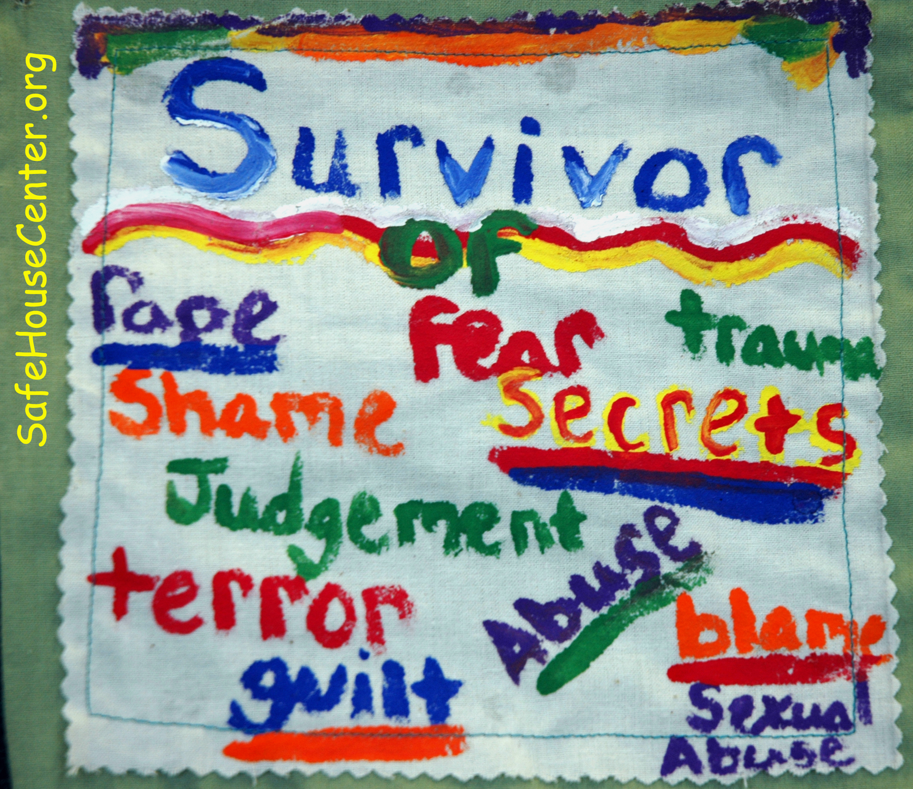
Know: DV is hidden
Guilt
Shame
Denial
Fear of retaliation
Fear of blame
Privacy
Notes:
Leighton, Paul. 2014. Understanding Domestic Violence. Available, http://paulsjusticepage.com/paul/pauls-cv.htm.

Slide 10
Why Care: It is a violent crime!
Violence causes trauma. Without proper support, the result can be
Hallucinations and dissociation
Depression, suicidal tendencies
Chronic anxiety
Hostility
Chronic fatigue syndrome
Eating disorders
Sexually Transmitted Diseases
Migraines
Substance abuse disorders
Indigestion, diarrhea, chronic irritable bowel syndrome
Self-injury
Cognitive impairments
Disease
Disability and premature death.
Witness Justice. Trauma – the “Common Denominator,” http://download.ncadi.samhsa.gov/ken/pdf/NCTIC/The_Science_of_Trauma.pdf.
Family Violence Prevention Fund, National Consensus Guidelines on Identifying and Responding to Domestic Violence Victimization in Health Care Settings. http://www.endabuse.org/userfiles/file/Consensus.pdf
Notes:
Leighton, Paul. 2014. Understanding Domestic Violence. Available, http://paulsjusticepage.com/paul/pauls-cv.htm.

Slide 11

Why Care: Prevalence
More than 1 in 3 women (35.6%) and more than 1 in 4 men (28.5%) have experienced rape, physical violence, and/or stalking by an intimate partner in their lifetime
Nearly 1 in 5 women (18.3%) and 1 in 71 men (1.4%) have been raped at some time in their lives
  Perpetrators are mostly partners or acquaintances
Centers for Disease Control and Prevention, National Intimate Partner and Sexual Violence Survey, 2010 Report http://www.cdc.gov/violenceprevention/pdf/nisvs_report2010-a.pdf
Notes:
Leighton, Paul. 2014. Understanding Domestic Violence. Available, http://paulsjusticepage.com/paul/pauls-cv.htm.

Slide 12
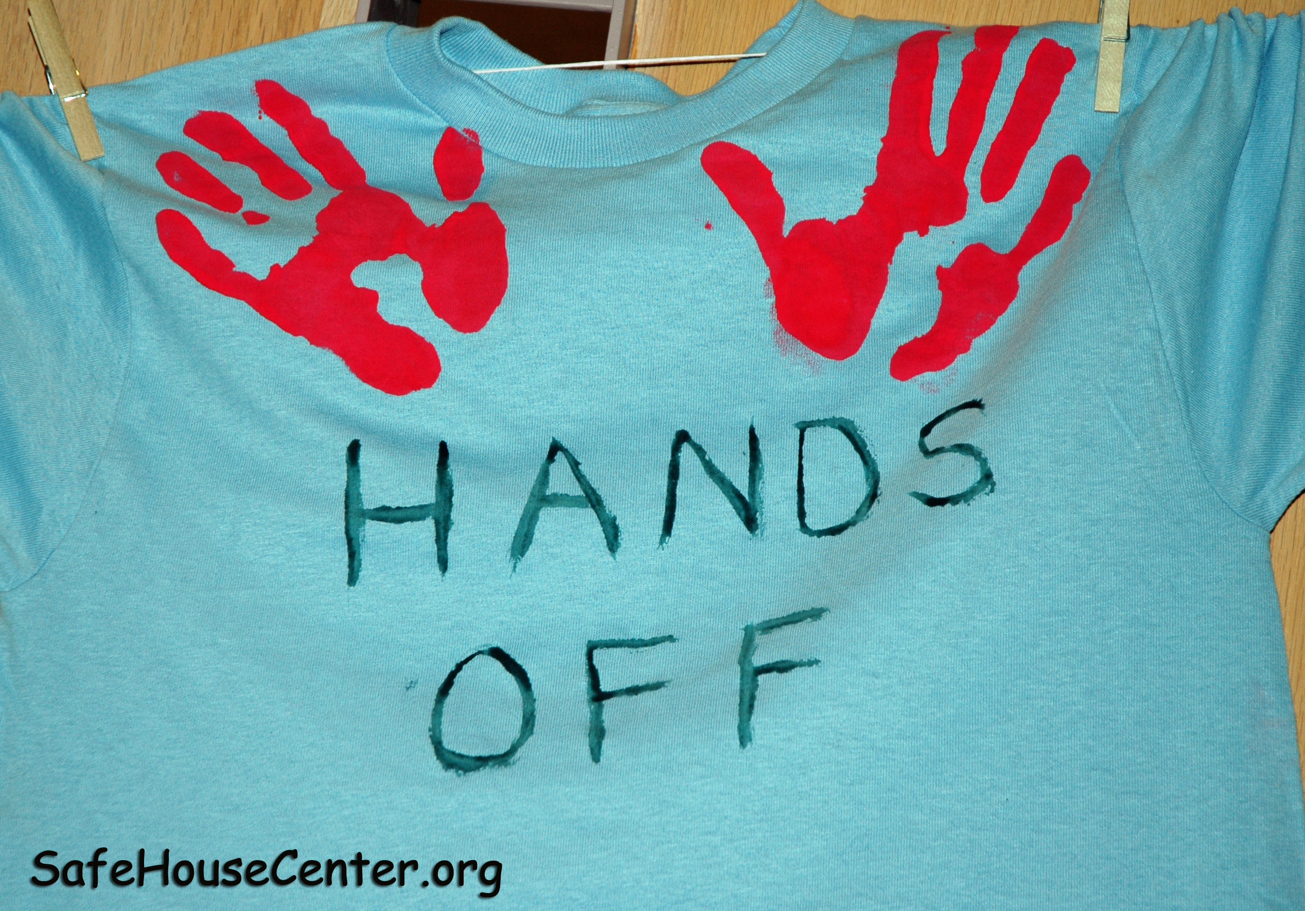
Why Care: health impact on pregnancy
“Six percent of all pregnant women are battered and pregnancy complications, including low weight gain, anemia, infections, and first and second trimester bleeding, are significantly higher for abused women, as are maternal rates of depression, suicide attempts, and substance abuse.”
Family Violence Prevention Fund, National Consensus Guidelines on Identifying and Responding to Domestic Violence Victimization in Health Care Settings. http://www.endabuse.org/userfiles/file/Consensus.pdf
Notes:
Leighton, Paul. 2014. Understanding Domestic Violence. Available, http://paulsjusticepage.com/paul/pauls-cv.htm.

Slide 13

Why Care: Effect on children
Children who witness domestic violence may suffer: PTSD, nightmares, depression, learning difficulties, aggressive behavior and substance abuse.
U.S. Department of Health and Human Services. Mental Health: A Report of the Surgeon General.
http://www.surgeongeneral.gov/library/mentalhealth/home.html
Family Violence Prevention Fund, National Consensus Guidelines on Identifying and Responding to Domestic Violence Victimization in Health Care Settings. http://www.endabuse.org/userfiles/file/Consensus.pdf
Notes:
Leighton, Paul. 2014. Understanding Domestic Violence. Available, http://paulsjusticepage.com/paul/pauls-cv.htm.

Slide 14
Why Care: Economic Costs
The costs of intimate partner rape, physical assault, and stalking exceed $5.8 billion each year (2003 $)
nearly $4.1 billion is for direct medical and mental health care services.
nearly $1.8 billion is indirect costs of lost productivity and earnings
National Center for Injury Prevention and Control. Costs of Intimate Partner Violence Against Women in the United States. Atlanta (GA): Centers for Disease Control and Prevention; 2003.
http://www.cdc.gov/ncipc/pub-res/ipv_cost/ipvbook-final-feb18.pdf
CDC, Intimate Partner Violence: Consequences, http://www.cdc.gov/violenceprevention/intimatepartnerviolence/consequences.html
Notes:
Leighton, Paul. 2014. Understanding Domestic Violence. Available, http://paulsjusticepage.com/paul/pauls-cv.htm.

Slide 15
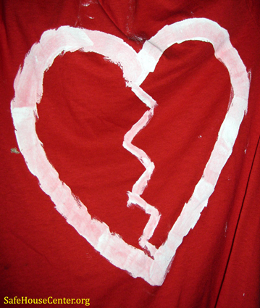
Why Care: Battered Women Need Your Help
On Sept 17, 2013
[one day!]
 | Whole US | Michigan
Victims Served | 66,581 | 2,293
Emergency Shelter | 23,517 (50% children) | 801
Hotline calls | 20,267 | 409
Unmet Requests | 9,641 (5,778 for shelter*) | 200
* 60% return to abuser, 38% homeless or live in car
National Network to End Domestic Violence, Domestic Violence Counts 2013. http://nnedv.org/projects/census.html
Notes:
Leighton, Paul. 2014. Understanding Domestic Violence. Available, http://paulsjusticepage.com/paul/pauls-cv.htm.

Slide 16
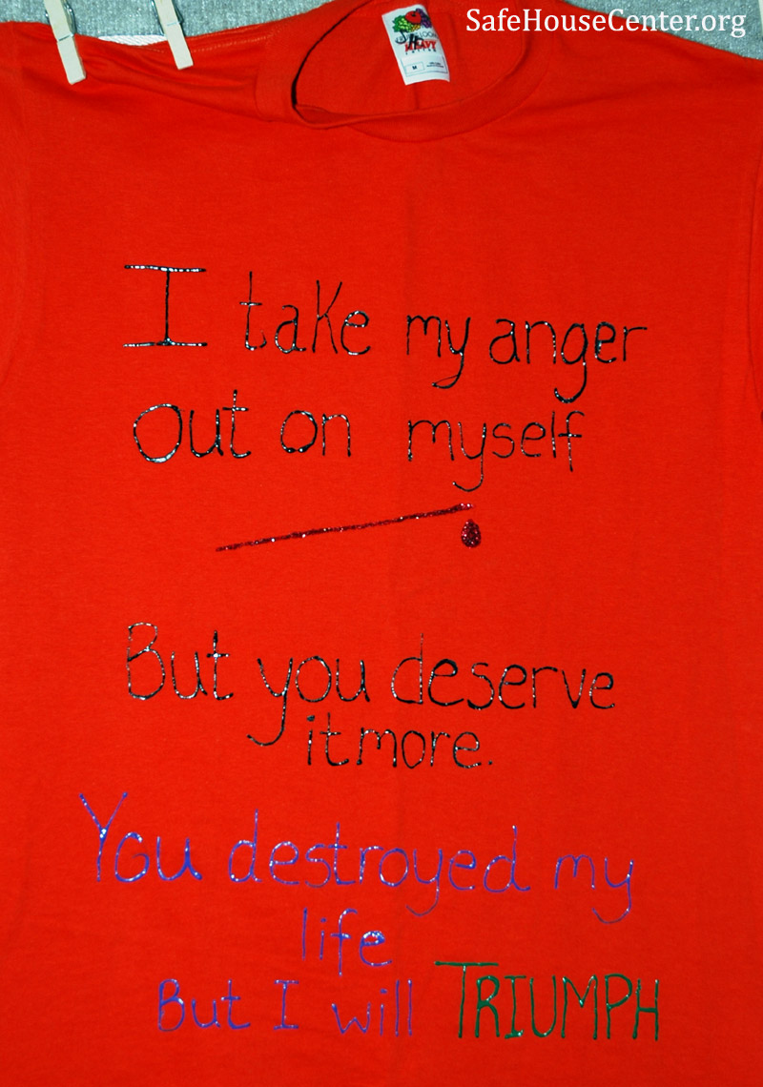
Help: Key messages
You are not alone
This is not your fault
  How much do you blame the victims of other crimes?
There is help available
You [no one] deserves to be treated this way
“Would you like to tell me what happened?”
  Don’t trigger blame: Why did you do that, wear that, say that, go there…
Notes:
Leighton, Paul. 2014. Understanding Domestic Violence. Available, http://paulsjusticepage.com/paul/pauls-cv.htm.

Slide 17
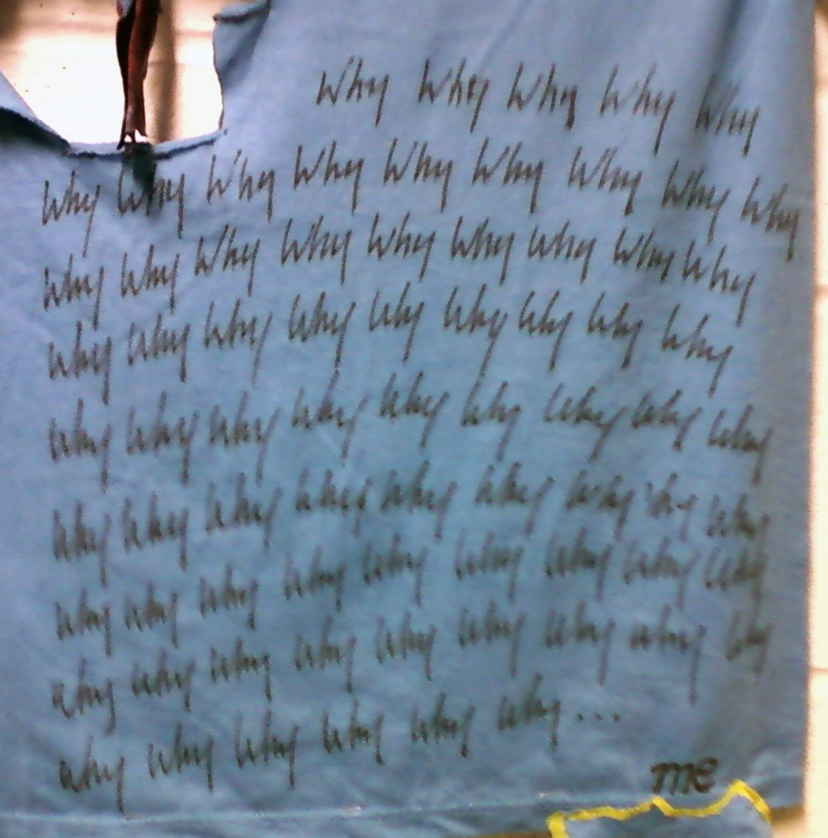
Help: How is a survivor feeling?
Responsible
Angry
Hopeful
Scared
Unsteady
Determined
Resilient
Victimized
Slide text courtesy of Barbara Niess-May
Notes:
Leighton, Paul. 2014. Understanding Domestic Violence. Available, http://paulsjusticepage.com/paul/pauls-cv.htm.

Slide 18
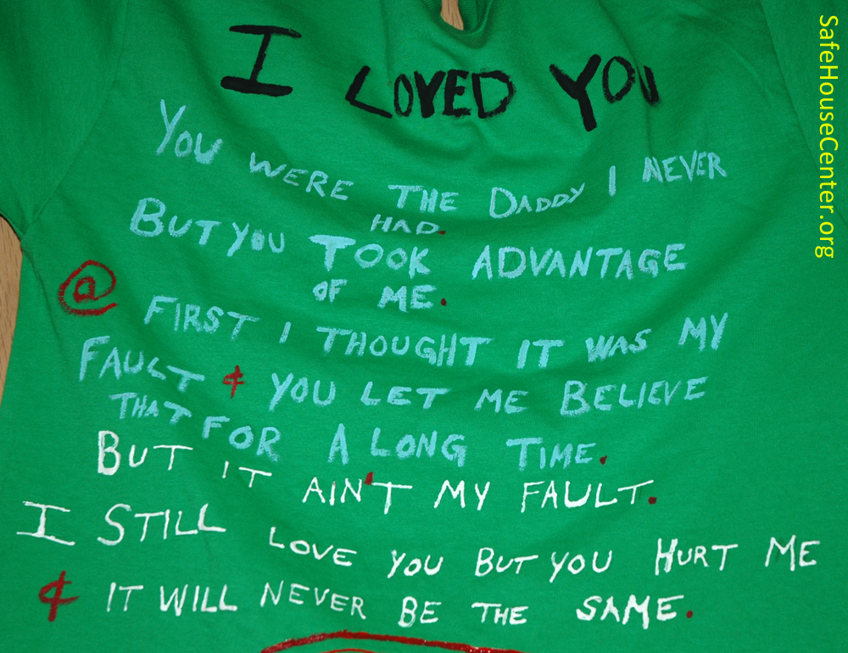
Help: Understand Love
She may love him, not the abuse
She wants the abuse to end, not the relationship
Notes:
Leighton, Paul. 2014. Understanding Domestic Violence. Available, http://paulsjusticepage.com/paul/pauls-cv.htm.

Slide 19
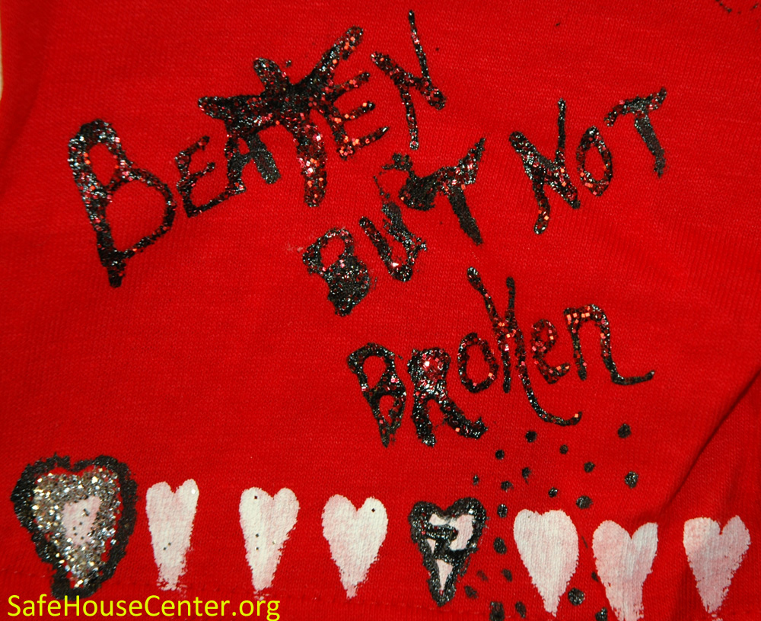
Help: Empower, don’t order
DV or SA means person is experiencing profound loss of control over life.
Orders or appeals to authority will not be effective.
Empower person by providing options and information so they can choose.
Notes:
Leighton, Paul. 2014. Understanding Domestic Violence. Available, http://paulsjusticepage.com/paul/pauls-cv.htm.

Slide 20
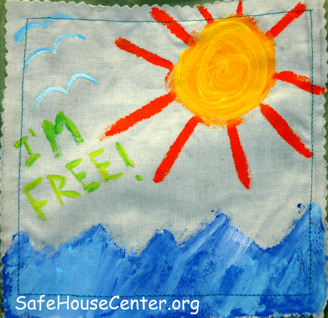
Help: Safety Plan
Leaving is the most dangerous time.
  Abuser escalates to re-establish control
“I’m worried about your safety and would like to help you make a plan so it will be there if/when you want to leave”
  Keys, $, ID, clothing, personal items
Notes:
Leighton, Paul. 2014. Understanding Domestic Violence. Available, http://paulsjusticepage.com/paul/pauls-cv.htm.

Slide 21
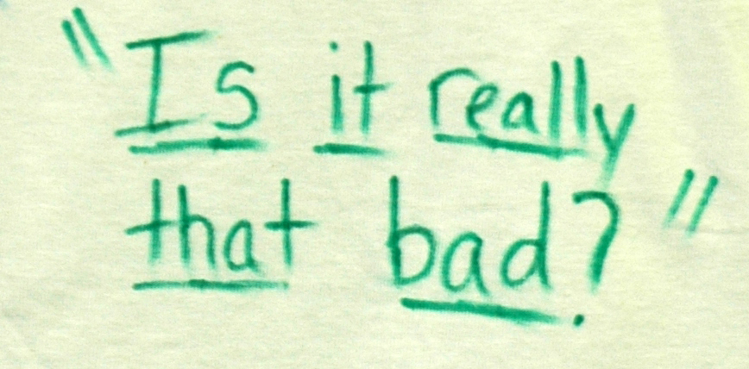
Help: Understand (“over”) reactions
May still be minimizing or not sharing all aspects of abuse (esp. sexual abuse)
Past traumas (abuse, incest, rape) and current situations (workplace sexual harassment) can factor into current response
Notes:
Leighton, Paul. 2014. Understanding Domestic Violence. Available, http://paulsjusticepage.com/paul/pauls-cv.htm.

Slide 22

Help: Ask for help yourself
Call DV hotline
“This is a non-emergency call. I’m trying to help a friend.
Is this a good time for you?”
1−800−799−7233
SAFE
Notes:
Leighton, Paul. 2014. Understanding Domestic Violence. Available, http://paulsjusticepage.com/paul/pauls-cv.htm.

Slide 23

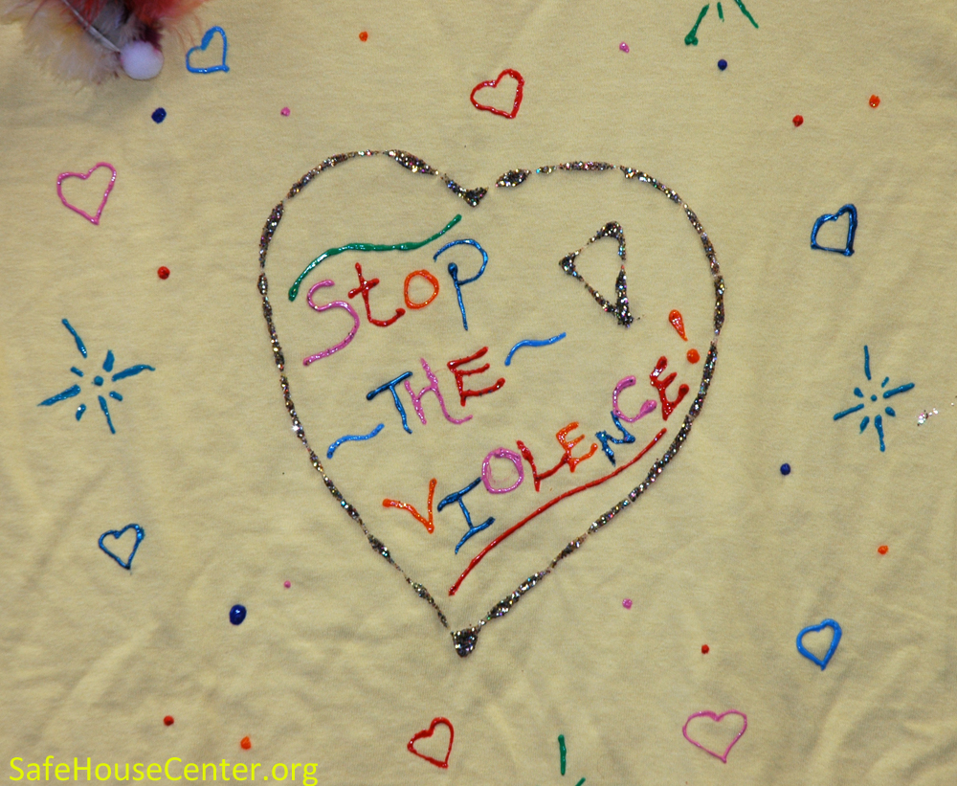
Help: Don’t Give Up
Paul’s Domestic Violence class webpage: http://paulsjusticepage.com/emu/crm550.htm
Notes:
Leighton, Paul. 2014. Understanding Domestic Violence. Available, http://paulsjusticepage.com/paul/pauls-cv.htm.

Slide 24
Dr. Paul Leighton is a professor in the Department of Sociology, Anthropology & Criminology at Eastern Michigan University. He has been teaching a graduate level course on domestic violence and sexual assault for most of the 17 years he has been at EMU. Leighton served six years, including two as president, on the board of SafeHouseCenter.org.
More information about him is available on his website,
http://paulsjusticepage.com/paul/pauls-cv.htm
His DV and SA class
http://paulsjusticepage.com/emu/crm550.htm

