Slide 1
The Problems with Private Prisons
Dr. Paul Leighton
Eastern Michigan University (USA)
Revised presentation originally done for
World Congress, International Society for Criminology
Kobe, Japan: 7 August 2011

Slide 2
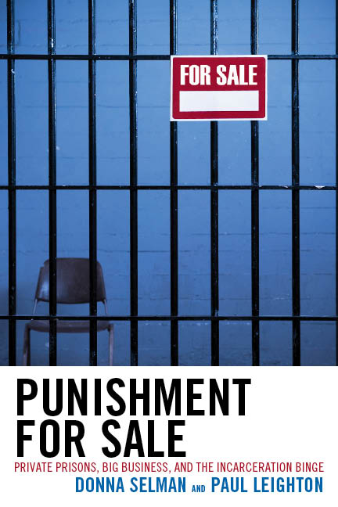
Adapted from:
Selman and Leighton, Punishment for Sale: Private Prisons, Big Business and the Incarceration Binge
(Rowman & Littlefield, 2010)

Slide 3
Definition
Nominal privatization includes contracting with private companies for services such as the building and construction of prisons, provision of food services, medical care and commissary supplies.
Operational privatization involves a private company operating a facility owned by the government or managing inmates in a prison that the company owns.
Private Finance Initiatives (PFI) and Private-Public Partnerships (PPP)can represent nominal or operational privatization

Slide 4
History
U.S. War on Crime/Drugs Incarceration Binge
Disproportionate minority confinement, undermining informal community social controls, social exclusion
Governments could not build and renovate prisons fast enough, esp while promising smaller govt/lower taxes
Private prisons raised money from “public” [wealthy] to continue incarceration binge of poor and profit
Private prisons were born from unjust policy; they depend on its continuation for growth and profit

Slide 5
Big Players
Corrections Corp of America [CXW]
operates 66 facilities, including 45 facilities that they own, with a total design capacity of approximately 90,000
“leveraged capital structure”: $1.2 billion in debt (bonds, loans from Wall St investment banks)
2010 revenue = $1.7 billion
GEO Group, formerly Wackenhut [GEO]
management of correctional, detention, mental health, residential treatment and re-entry facilities, and the provision of community based services and youth services in the United States, Australia, South Africa, the United Kingdom and Canada
approximately 81,000 beds at 118 facilities + community corrections
$1 billion in debt (bonds, loans from Wall St investment banks)
2010 revenue = $1.3 billion

Slide 6
Legitimacy
Just because private prisons exist does not negate the question of whether government should be searching for the lowest bidder to administer government’s monopoly on coercive power.
DiIulio argues that “it is simply unclear how one can distinguish morally between private and public courts, and between private and public policing, and yet see no moral difference between private and public corrections.”
Private Supermax facilities? Death row? Executions?

Slide 7
Business Model
Revenue measured in “compensated man day” = per diem (daily) fee per inmate
High fixed costs [admin, staffing, construction], low marginal costs [food, clothing]
Economies of scale encourage acquisitons/mergers
MAXIMUM PROFITS from high occupancy
Lobby govt for access to “raw materials [prisoners]” (Christie) and “bodies destined for profitable punishment” (Davis)

Slide 8
Contracts
Weak link in “chain of command” between The People and Corrections Officer
Supposedly balance corporate interests [profit, duties to shareholders] with public interest [public safety, accountability]
No opportunity for public review while being negotiated
Freedom of Information Act requests are slow and sometimes difficult

Slide 9
Process
Research promising jurisdictions
Lobbyists, Campaign Donations
Hire local officials or ex-govt employees as consultants [watch for conflict of interest]
Once there is authorization, govt writes Request for Proposals (RFP), often hundreds of pages describing the service, staffing, health care expectations, etc. Expensive process!
Firms hope to be involved and help govt “define its needs”

Slide 10
Contract Problems
Weak and flawed systems of monitoring
Companies deal with more contracts and better understand the profit-making potential of certain contractual language
Maintenance
Few penalties for violating contract, insufficient for deterrence
“Take or Pay”: Pay for 90 or 95% occupancy regardless of actual number of inmates
guaranteed revenue for corporation, questionable benefits for govt that pays for “ghost” inmates

Slide 11
Private prisons save little
“it was discovered that, rather than the projected 20 percent savings, the average saving from privatization was only about 1 percent, and most of that was achieved through lower labor costs.”
James Austin and Garry Coventry, “Emerging Issues on Privatized Prisons” U.S. Department of Justice, Bureau of Justice Assistance, February 2001, NCJ 181249, p. iii.

Slide 12
Promote Inequality: Top Wage in Public DOC v Private Prisons, 2007
CEO salary excludes stocks and stock options. Inmates under supervision excludes probation and parole.
Notes:
Highlight inmates comparison GEO = Michigan or New York (if we don’t count parole or probation); CCA = Florida
Fiscal Responsibility comparison GEO smaller than Georgia; CCA = Michigan

Slide 13
Add to Prison-Industrial Complex
From General/President Eisenhower’s warning of Military-Industrial Complex
New permanent armaments industry of “vast proportions”
“We must guard against the acquisition of unwarranted influence… The potential for the disastrous rise of misplaced power exists and will persist. We must never let the weight of this combination endanger our liberties or democratic processes.
Complex forms policy in own interest, minimizes outside scrutiny and accountability
“Iron Triangle” of legislators, bureaucrats and corp interests

Slide 14
“Endanger our liberties or democratic processes”
GEO Group, 2010 Annual Report “Risk Factors”:
the demand for our services could be adversely affected by changes in existing criminal or immigration laws, the relaxation of criminal or immigration enforcement efforts, sentencing or deportation practices, and the decriminalization of certain activities or the loosening of immigration laws. For example, any changes with respect to the decriminalization of drugs and controlled substances could affect the number of persons arrested, convicted, sentenced and incarcerated, thereby potentially reducing demand for correctional facilities to house them.

Slide 15
“Endanger our liberties or democratic processes”
Drug policy, immigration and sentencing ranges should be decided on the basis of justice and public safety.
They should not be based on the profitability of prison corporations, investment returns for wealthy whites or Wall Street investment banks.
Billions of $ in loans and stocks linked to punitiveness
But they are:
Lobbying (most recently on Arizona’s immigration law)
ALEC (American Legislative Exchange Council) – corp “ghostwriting” of legislation

Slide 16
Conclusion
Undermine punishment in name of public
Poor transparency/corp proprietary info
Contracts provide poor accountability
Little cost savings
Add to inequality (Pay executives more and workers less than public counterparts)
Add to prison-industrial complex/vested interests in more unjust mass incarceration
Corporate interests corrupt democratic policy- making about justice and public safety

Slide 17
Dr. Paul Leighton is a professor in the Department of Sociology, Anthropology & Criminology at Eastern Michigan University.
More information about him is available on his website,
http://paulsjusticepage.com/paul/pauls-cv.htm
I believe and hope my use of the images in this
Presentation is covered by ‘fair use.’ Requests to
remove materials should be sent to the presenter
through his address on this page
http://paulsjusticepage.com/paul.htm

