Slide 1
Models of Privatization and Public-Private Partnerships with Prisons:
An Incomplete Survey
Dr. Paul Leighton
Eastern Michigan University
East Asian Law & Society Conference
August, 2015
Tokyo, Japan
Notes:
Leighton, Paul. 2015. Models of Privatization and Public-Private Partnerships with Prisons: An Incomplete Survey
http://www.paulsjusticeblog.com/2015/08/private_prisons_an_incomplete_survey.php

Slide 2
Roadmap
Dimensions of Privatization
Israel
US Privatization
Japanese Private Finance Initiative (PFI) Act
Australia - Ravenhall
Conclusions
This is a slightly expanded version of what was presented at the conference. It adds to a few slides to reflect what was spoken and incorporates some ideas from later conversations about the session.
Notes:
Leighton, Paul. 2015. Models of Privatization and Public-Private Partnerships with Prisons: An Incomplete Survey
http://www.paulsjusticeblog.com/2015/08/private_prisons_an_incomplete_survey.php

Slide 3
Dimensions of Privatization
Legal – and ethical – basis for privatization?
How much privatization?
What functions?
How many prisons?
What type of control and oversight?
New form of prison,
or privatize status quo prison?
Partnerships
How many?
For profit or non-profit partners?
Notes:
Leighton, Paul. 2015. Models of Privatization and Public-Private Partnerships with Prisons: An Incomplete Survey
http://www.paulsjusticeblog.com/2015/08/private_prisons_an_incomplete_survey.php

Slide 4
Israel
Legal – and ethical – basis for privatization?
NO!
2004 Prisons Ordinance Amendment Law: construct, manage and operate for the first time, a (single) 800 person prison that will be operated and managed by a private corporation rather than by the state.
Relieve overcrowding and save money
Struck down in 2009 by High Court of Justice
Notes:
Leighton, Paul. 2015. Models of Privatization and Public-Private Partnerships with Prisons: An Incomplete Survey
http://www.paulsjusticeblog.com/2015/08/private_prisons_an_incomplete_survey.php

Slide 5
Israel II
Academic Center of Law and Business v. Minister of Finance
Transfer of powers to a “private profit-making corporation” (emphasis added) that had been selected.
Transfer of powers that, “when exercised, involve a serious violation of the rights to personal liberty and human dignity. These powers include, inter alia, the power to order an inmate to be held in administrative isolation for a maximum period of 48 hours; the power to order the conducting of an external examination of the naked body of an inmate; … the power to approve the use of reasonable force in order to carry out a search on the body of an inmate.”
Notes:
Leighton, Paul. 2015. Models of Privatization and Public-Private Partnerships with Prisons: An Incomplete Survey
http://www.paulsjusticeblog.com/2015/08/private_prisons_an_incomplete_survey.php

Slide 6
Israel III
Academic Center of Law and Business v. Minister of Finance
Powers transferred to guards include “the power to use a weapon in order to prevent the escape of an inmate from the prison, the power given to a policeman to arrest and detain a person without a warrant” [citations omitted].
Amendment 28 inherently “leads to a violation of the constitutional rights to personal liberty and human dignity of inmates.”
Notes:
Leighton, Paul. 2015. Models of Privatization and Public-Private Partnerships with Prisons: An Incomplete Survey
http://www.paulsjusticeblog.com/2015/08/private_prisons_an_incomplete_survey.php

Slide 7
U.S.
Nominal privatization: contracting for construction, food, medical care, education
1986: Operational privatization: private company manages a facility owned by the government and/or a prison that the company owns.
Both are multinational corps, traded on stock exchange. For-profit Real Estate Investment Trusts – pay no federal tax and distribute money to shareholders instead
Notes:
Leighton, Paul. 2015. Models of Privatization and Public-Private Partnerships with Prisons: An Incomplete Survey
http://www.paulsjusticeblog.com/2015/08/private_prisons_an_incomplete_survey.php

Slide 8
U.S. II
Overcrowding and “incarceration binge,” need more prisons but politicians promise smaller govt/lower taxes
Private prisons raised billions from investors seeking to profit from incarceration, disproportionately of minorities
Notes:
Leighton, Paul. 2015. Models of Privatization and Public-Private Partnerships with Prisons: An Incomplete Survey
http://www.paulsjusticeblog.com/2015/08/private_prisons_an_incomplete_survey.php

Slide 9
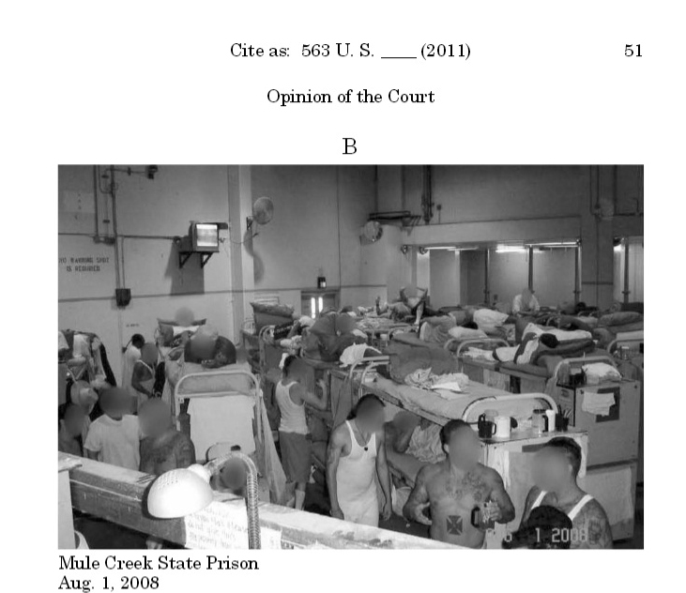
U.S. III
Warehouse prison problem:
“there is still too much violence in America’s prisons and jails, too many facilities that are crowded to the breaking point, too little medical and mental health care, unnecessary uses of solitary confinement and other forms of segregation, a desperate need for the kinds of productive activities that discourage violence and make rehabilitation possible.” (Commission on Safety and Abuse in America’s Prisons 2006, p. 390)
Private Prisons enable the expansion and maintenance of too many warehouse prisons
From Supreme Court decision in Brown v Plata.
“Needless suffering and death have been well-documented.” (p 3)
Notes:
Leighton, Paul. 2015. Models of Privatization and Public-Private Partnerships with Prisons: An Incomplete Survey
http://www.paulsjusticeblog.com/2015/08/private_prisons_an_incomplete_survey.php

Slide 10
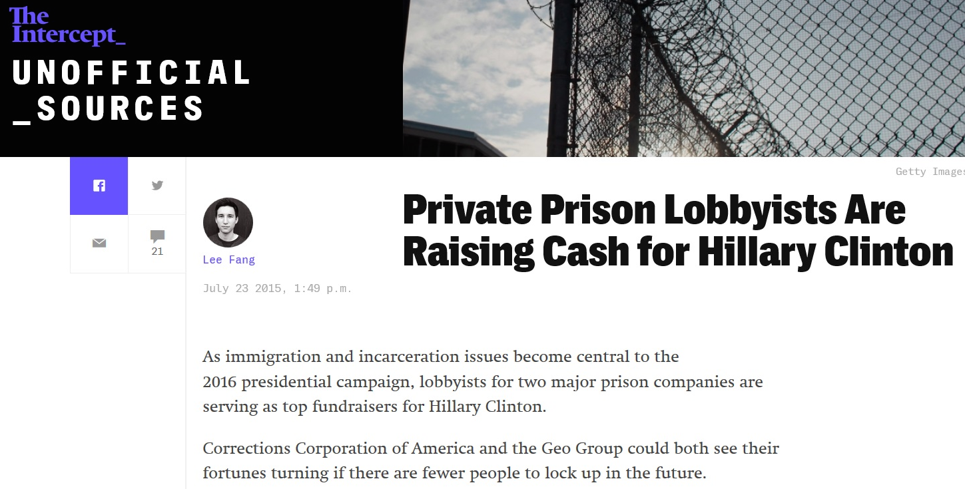
U.S. IV
“Endanger democratic processes”
GEO Group, 2010 Annual Report “Risk Factors”:
“the demand for our services could be adversely affected by the relaxation of criminal or immigration enforcement efforts, sentencing or deportation practices, … [f]or example, any changes with respect to the decriminalization of drugs.”
See, Buying Access: How Corporations Influence Decision Makers at Corrections Conferences, Trainings, and Meetings (In the Public Interest ([2015])
Notes:
Leighton, Paul. 2015. Models of Privatization and Public-Private Partnerships with Prisons: An Incomplete Survey
http://www.paulsjusticeblog.com/2015/08/private_prisons_an_incomplete_survey.php

Slide 11
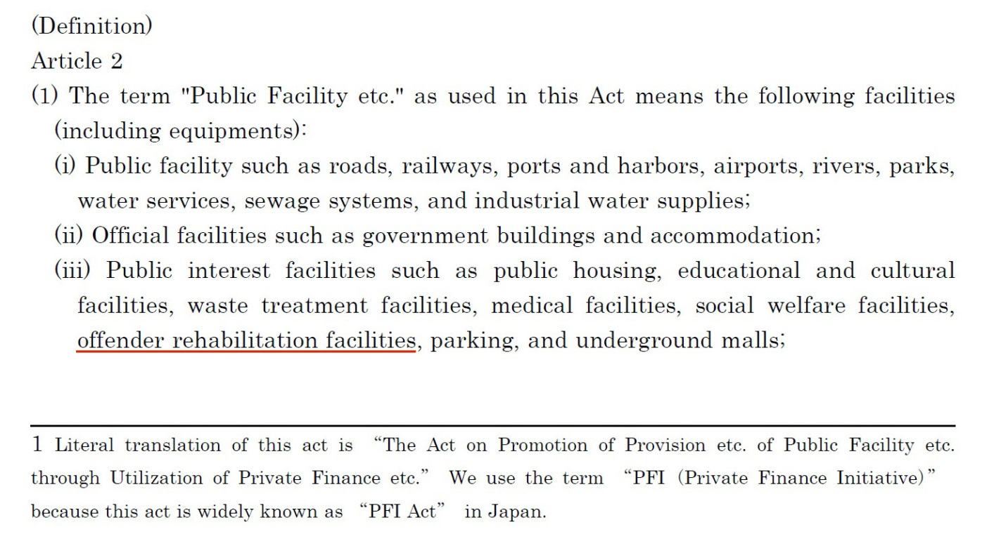
Japan
1999 Act on Promotion of Private Finance Initiative (PFI)
Public private partnerships for “offender rehabilitation facilities” – not prisons
50 localities wanted one, built 4
Notes:
Leighton, Paul. 2015. Models of Privatization and Public-Private Partnerships with Prisons: An Incomplete Survey
http://www.paulsjusticeblog.com/2015/08/private_prisons_an_incomplete_survey.php

Slide 12
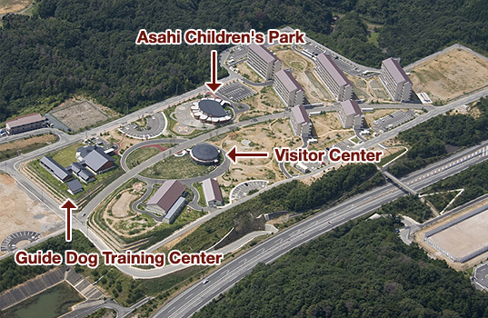
3 “pillars” of PFI Shimane Asahi Rehabilitation Center
Japan II
Public-private partnership
Technology and innovation
Education, vocational training and rehabilitative programs
Special programs, training and therapeutic gardens for emotionally disturbed inmates
Partnership with community
“Co-building” – Center for Regional Engagement
“aims to create prisons that the public can understand and support”
Shimane Asahi website, http://www.shimaneasahi-rpc.go.jp/english/first/index.html
Notes:
Leighton, Paul. 2015. Models of Privatization and Public-Private Partnerships with Prisons: An Incomplete Survey
http://www.paulsjusticeblog.com/2015/08/private_prisons_an_incomplete_survey.php

Slide 13
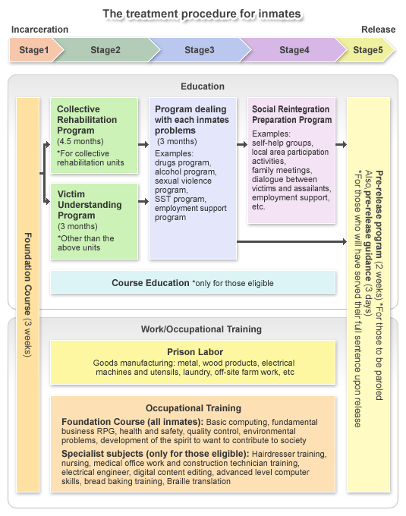
Japan III
All of the inmates at PFI prisons receive some kind of vocational training, compared to only 7.3 % of inmates of other prisons
Paul Leighton. 2014. “A model prison for the next 50 years”: The high-tech, public-private Shimane Asahi Rehabilitation Center. Justice Policy Journal, 11(1).
From Shimane Asahi website,
http://www.shimaneasahi-rpc.go.jp/english/torikumi/index.html
Notes:
Leighton, Paul. 2015. Models of Privatization and Public-Private Partnerships with Prisons: An Incomplete Survey
http://www.paulsjusticeblog.com/2015/08/private_prisons_an_incomplete_survey.php

Slide 14
Japan IV
Japan
U.S.
Government
Government
Warden,
Treatment, Support & Planning
Private
Sector Company
Warden
&
Staff
Private
Sector Companies
Notes:
Leighton, Paul. 2015. Models of Privatization and Public-Private Partnerships with Prisons: An Incomplete Survey
http://www.paulsjusticeblog.com/2015/08/private_prisons_an_incomplete_survey.php

Slide 15
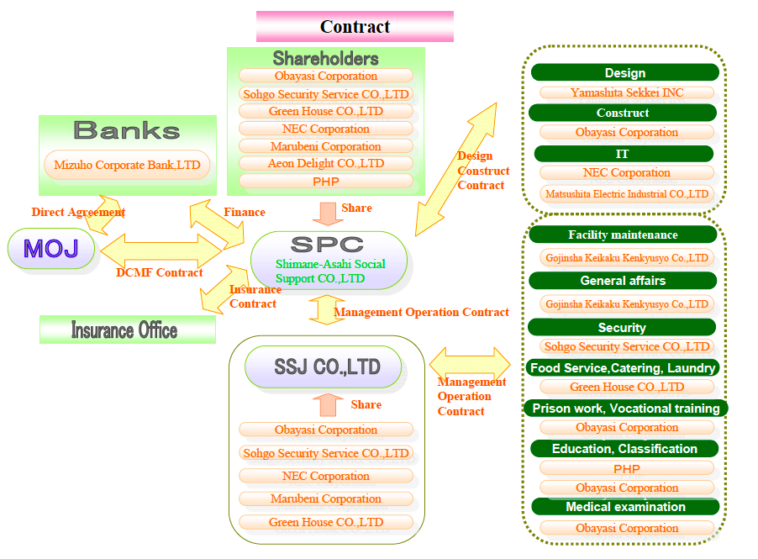
Japan V
No domination by a big corporation,
but complex structure to manage
From Akihiko Kimura, The Development of PFI in the Prison Sector in Japan. Presented at the 3rd Annual Meeting for PPP/PFI Promotion Between Japan and Korea
Notes:
Leighton, Paul. 2015. Models of Privatization and Public-Private Partnerships with Prisons: An Incomplete Survey
http://www.paulsjusticeblog.com/2015/08/private_prisons_an_incomplete_survey.php

Slide 16
Australia
Existing private prisons generally replicate status quo, but Ravenhall is new form.
$700 million for 1,300 bed near Melbourne opens late 2017
GEO Group (prison operator and equity investor), John Holland(builder), Honeywell (facilities management) and Capella Capital (financial adviser)
Partnerships Victoria:
Ravenhall Prison Project (2/2015 Summary)
Notes:
Leighton, Paul. 2015. Models of Privatization and Public-Private Partnerships with Prisons: An Incomplete Survey
http://www.paulsjusticeblog.com/2015/08/private_prisons_an_incomplete_survey.php

Slide 17
Australia II
Ravenhall
“It's an unprecedented level of in-prison and post-release programming. This will be unlike any other correctional facility in the world.” GEO CEO Zoley, Q2 2014 earnings call*
Ravenhall will have “collaborative partnerships with community-based organizations, which will allow offenders' release from custody to continue rehabilitation programs. Progressive accommodation units [and] … innovative use of in-cell IT-delivered programming.” GEO CEO Zoley, Q3 2014 earnings calls
Incentive fee to reduce recidivism rates: GEO promised a $2 million bonus payment if it cuts recidivism at Ravenhall by 12 per cent per year, compared to the overall Victoria prison system. Work starts on new 1,000-bed Ravenhall Prison in Melbourne, as prison population grows
*PR hyperbole, although this model is a move in the right direction
Notes:
Leighton, Paul. 2015. Models of Privatization and Public-Private Partnerships with Prisons: An Incomplete Survey
http://www.paulsjusticeblog.com/2015/08/private_prisons_an_incomplete_survey.php

Slide 18
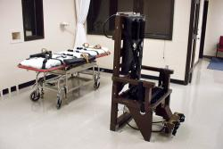
Conclusions
Because we have them does not make them legitimate
No for-profit police (private security have no power to arrest, use deadly force)
No for-profit courts (arbitration lacks enforcement and can usually appeal to court)
Why are for-profit prisons morally acceptable then?
Limits, even when acceptable:
For-profit executions?
For-profit business runs whole
state or national prison system?
Notes:
Leighton, Paul. 2015. Models of Privatization and Public-Private Partnerships with Prisons: An Incomplete Survey
http://www.paulsjusticeblog.com/2015/08/private_prisons_an_incomplete_survey.php

Slide 19
Conclusions II
State sometimes fixed or limited in how it manages, so some degree of privatization necessary to create a new model.
But, privatized prison and punishment most problematic when state contracts out core management function to for-profit business (esp large corporation)
Notes:
Leighton, Paul. 2015. Models of Privatization and Public-Private Partnerships with Prisons: An Incomplete Survey
http://www.paulsjusticeblog.com/2015/08/private_prisons_an_incomplete_survey.php

Slide 20
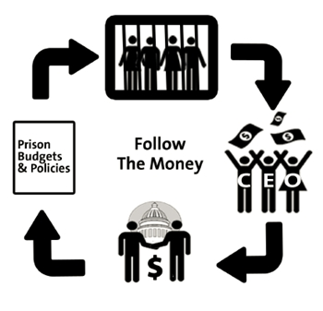
Conclusions III
Public-private partnerships that emphasize rehabilitation undercut the objection that private interests “profit from misery.” But larger objection is creation of “bodies destined for profitable punishment”.
Campaign contributions
Political lobbying
Economies of scale
(encourage bigness)
Perverse incentives
Mis-allocation of capital
Notes:
Leighton, Paul. 2015. Models of Privatization and Public-Private Partnerships with Prisons: An Incomplete Survey
http://www.paulsjusticeblog.com/2015/08/private_prisons_an_incomplete_survey.php

Slide 21
Conclusion IV
Privatization requires mechanisms for state to oversee business and hold them accountable.
Government should keep control of key management positions
Contracts need to be made public (accountability of politicians)
Contracts need to be well written and comprehensive
Effective oversight
Penalties greater than profit from wrongdoing
Notes:
Leighton, Paul. 2015. Models of Privatization and Public-Private Partnerships with Prisons: An Incomplete Survey
http://www.paulsjusticeblog.com/2015/08/private_prisons_an_incomplete_survey.php

Slide 22
Conclusion V
Financial savings is not a moral justification for privatization, which worsens problems of inequality.
Savings overstated because of industry-funded research and PR.
Any savings comes at expense of worker pay and salaries.
“A lot of jobs in government are middle-class jobs that in the private sector are not middle-class jobs. People aren’t willing to support conditions for public workers that they themselves no longer enjoy.” John Donahue, Kennedy School of Government at Harvard University
Private | Public
GEO CEO = $6 million (2012) | Dept of Corrections Director = less than $200,000
Guard = $30,460 (2010) | $39,040 (2010)
Salary only, does not include the value of benefits.
From Barak, Leighton and Cotton, Class, Race, Gender & Crime, 4th ed (from Securities and Exchange Commission and Bureau of Labor Statistics data)
Notes:
Leighton, Paul. 2015. Models of Privatization and Public-Private Partnerships with Prisons: An Incomplete Survey
http://www.paulsjusticeblog.com/2015/08/private_prisons_an_incomplete_survey.php

Slide 23
Dr. Paul Leighton is a Professor in the Department of Sociology, Anthropology & Criminology at Eastern Michigan University. He is the co-author of Punishment for Sale: Private Prisons, Big Business and the Incarceration Binge.
More information:
http://paulsjusticepage.com/paul/pauls-cv.htm
See also:
The Problems With Private Prisons,
http://www.paulsjusticeblog.com/2013/04/the_problems_with_private_prisons.php
Prison Privatization in the U.S. and Japan
http://www.paulsjusticeblog.com/2014/06/we_need_a_postwarehouse_prison.php
Why Private prisons Do Not Save Money
http://www.paulsjusticeblog.com/2014/10/why_private_prisons_do_not_save_money.php
Notes:
Leighton, Paul. 2015. Models of Privatization and Public-Private Partnerships with Prisons: An Incomplete Survey
http://www.paulsjusticeblog.com/2015/08/private_prisons_an_incomplete_survey.php

