Slide 1
The Rich Get Richer and the Poor Get Prison: Inequality, Corporate Power and Crime
Paul Leighton
Sidore Lecture
Plymouth State University
March 12, 2012
Notes:
Leighton, Paul. 2012. The Rich Get Richer and the Poor Get Prison: Inequality, Corporate Power and Crime. Available, http://www.paulsjusticeblog.com/2012/03/inequality_corporate_power_and_crime.php.

Slide 2
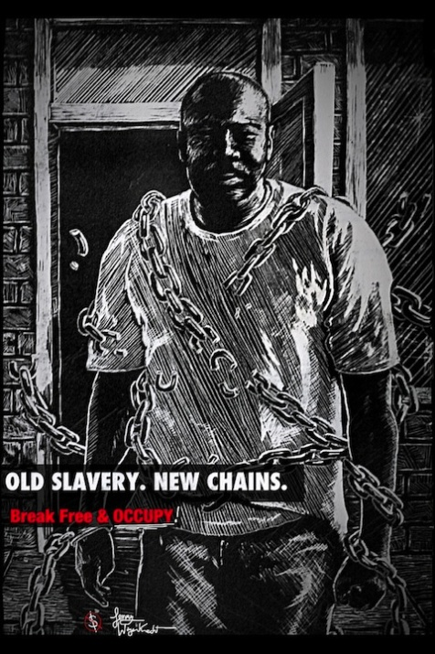
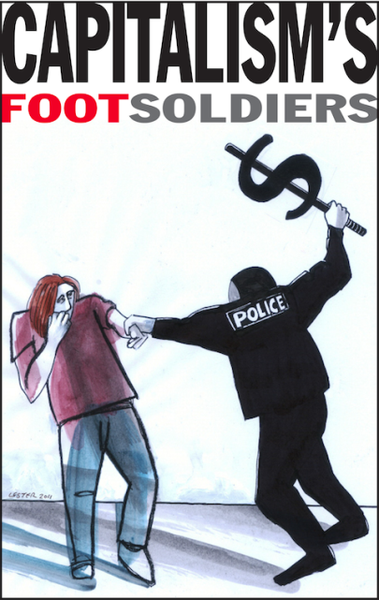
http://occuprint.org/
The creators of any graphics used in this presentation who want attribution or removal should contact me through my website, http://paulsjusticepage.com.
For more about this presentation, see
http://www.paulsjusticeblog.com/2012/03/inequality_corporate_power_and_crime.php.
Notes:
Leighton, Paul. 2012. The Rich Get Richer and the Poor Get Prison: Inequality, Corporate Power and Crime. Available, http://www.paulsjusticeblog.com/2012/03/inequality_corporate_power_and_crime.php.

Slide 3
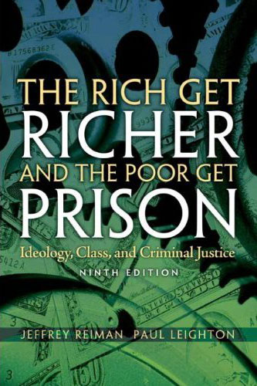
Roadmap
Inequality
Income
Wealth
Corporate ‘persons’ and inequality
Criminology
Inequality and street crime
Inequality and corporate crime
GE: corporate criminals own media
Conclusion
Notes:
Leighton, Paul. 2012. The Rich Get Richer and the Poor Get Prison: Inequality, Corporate Power and Crime. Available, http://www.paulsjusticeblog.com/2012/03/inequality_corporate_power_and_crime.php.

Slide 4
Defining Class
Think about class as a hand of cards, with the suits representing
Education
Income
Occupation
Wealth
“What explains how people locate themselves and others in a structure of inequality?”
Scott, Janny, and David Leonhardt. 2005. “Class in America: Shadowy Lines That Still Divide.” New York Times, May 15. Wright, Erik Olin, 1997. Class Counts. Cambridge: Cambridge University Press.
Notes:
Leighton, Paul. 2012. The Rich Get Richer and the Poor Get Prison: Inequality, Corporate Power and Crime. Available, http://www.paulsjusticeblog.com/2012/03/inequality_corporate_power_and_crime.php.

Slide 5
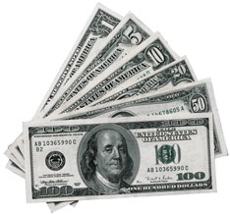
Income Overview
For most people, INCOME = SALARY
For richer, it includes interest and
dividends (not capital gains in
Census data)
Median household income was $49,445 in 2010
Official poverty rate = 15.1% (22% for children)
46.2 million people is the largest number in the 52 years for which poverty estimates have been published
DeNavas-Walt, Carmen, Bernadette D. Proctor, and Jessica C. Smith, U.S. Census Bureau, Current Population Reports, P60-239, Income, Poverty, and Health Insurance Coverage in the United States: 2010, U.S. Government Printing Office, Washington, DC,2011. http://www.census.gov/hhes/www/income/income.html.
Notes:
Leighton, Paul. 2012. The Rich Get Richer and the Poor Get Prison: Inequality, Corporate Power and Crime. Available, http://www.paulsjusticeblog.com/2012/03/inequality_corporate_power_and_crime.php.

Slide 6
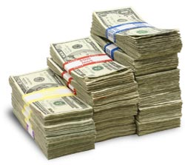
Income Privilege
Both high and low income tend to spend much of what they make, so you can still be “rich” and have class privilege if you have $0 at the end of the month.
Consider:
I can buy things for my comfort
I do not fear being hungry or homeless
I have the time and money to take care of my body
I do not worry about my access to medical care
I have the freedom to be unaware of the working conditions of others
I do not need public transportation
Pease, Bob. 2010. Undoing Privilege (Zed Books)
Notes:
Leighton, Paul. 2012. The Rich Get Richer and the Poor Get Prison: Inequality, Corporate Power and Crime. Available, http://www.paulsjusticeblog.com/2012/03/inequality_corporate_power_and_crime.php.

Slide 7
Income Distribution, 2010
Households | Share of Aggregate Income | Upper Limit (You are in this group if you make less than…)
Lowest Fifth | 3.3% | $20,000
Second Fifth | 8.5% | $38,043
Third Fifth | 14.6% | $61,735
Fourth Fifth | 23.4% | $100,065
Highest Fifth | 50.2%
Top 5% | 21.3% | Lower limit = $180,810
??
James Cameron = $257 million
Tiger Woods = $90.5 million
Larry Ellison = $84.5 million
U.S. Census Bureau, Current Population Survey, Annual Social and Economic Supplements, Tables H-1 and H-2
http://www.census.gov/hhes/www/income/data/historical/household/
Barr, Colin and David Goldman. 2010. 20 highest paid CEOs. http://money.cnn.com/galleries/2010/news/1004/gallery.top_ceo_pay/.
Freedman, Jonah. No date. The 50 highest-earning American athletes. http://sportsillustrated.cnn.com/specials/fortunate50-2010/index.html.
Hollywood’s Highest Paid Stars 2011. http://www.therichest.org/entertainment/vanityfairtop-40-highest-paid-stars-in-hollywood/
Notes:
Leighton, Paul. 2012. The Rich Get Richer and the Poor Get Prison: Inequality, Corporate Power and Crime. Available, http://www.paulsjusticeblog.com/2012/03/inequality_corporate_power_and_crime.php.

Slide 8
Income Inequality Over Time
CNN. 2011. How the middle class became the underclass http://money.cnn.com/2011/02/16/news/economy/middle_class/index.htm?iid=MPM
For data used to build graph, see Emmanual Saez’s webpage, http://elsa.berkeley.edu/~saez/.
Notes:
Leighton, Paul. 2012. The Rich Get Richer and the Poor Get Prison: Inequality, Corporate Power and Crime. Available, http://www.paulsjusticeblog.com/2012/03/inequality_corporate_power_and_crime.php.

Slide 9
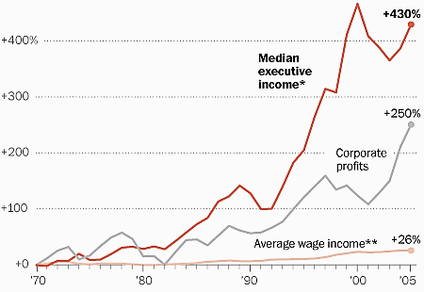
Income Inequality: Executive Pay
Repeated surveys “since 1987 have found that 60 percent or more of Americans agree or strongly agree with the statement that ‘differences in income in America are too large.’”
* Based on the salary, bonuses and stock options of the three highest-paid officers in the largest 50 firms.
** Calculated from Bureau of Economic Analysis data.
NOTE: All figures have been adjusted for inflation.
Whoriskey, Peter. 2011. With executive pay, rich pull away from rest of America. Washington Post, June 18. http://www.washingtonpost.com/business/economy/with-executive-pay-rich-pull-away-from-rest-of-america/2011/06/13/AGKG9jaH_story.html.
Notes:
Leighton, Paul. 2012. The Rich Get Richer and the Poor Get Prison: Inequality, Corporate Power and Crime. Available, http://www.paulsjusticeblog.com/2012/03/inequality_corporate_power_and_crime.php.

Slide 10
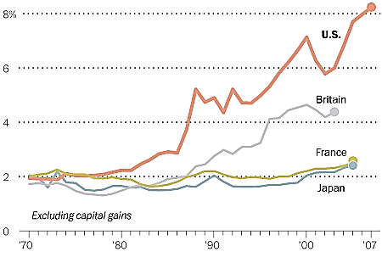
Income Inequality: International Comparisons
Share of income earned by top 0.1%
Washington Post. No date. (NOT) Spreading the Wealth
http://www.washingtonpost.com/wp-srv/special/business/income-inequality/.
Notes:
Leighton, Paul. 2012. The Rich Get Richer and the Poor Get Prison: Inequality, Corporate Power and Crime. Available, http://www.paulsjusticeblog.com/2012/03/inequality_corporate_power_and_crime.php.

Slide 11
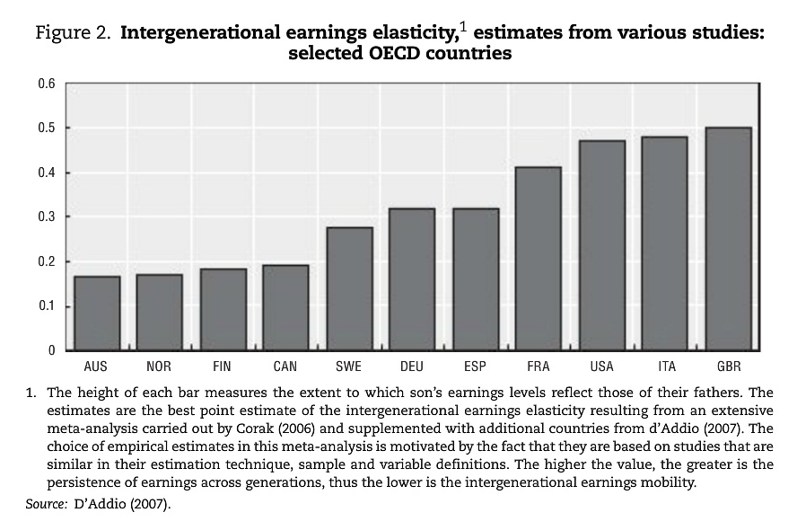
Intergenerational Mobility
Causa, Orsetta and Asa Johansson. 2010. Intergenerational Social
Mobility in OECD Countries.
OECD Journal: Economic
Studies, Volume 2010.
p 3 (quote) and p 9 (chart)
“Low mobility across generations, as measured by a close link between parents’ and children’s earnings, is particularly pronounced in the United Kingdom, Italy, the United States and France, while mobility is higher in the Nordic countries, Australia and Canada.”

Slide 12
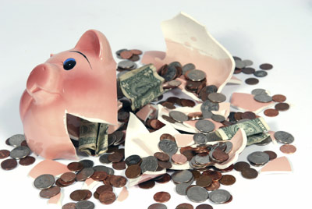
Wealth Overview
Wealth (net worth) = assets – liabilities
Median net worth, 2007 = $120,300
[mean = $556,300]
White, non-Hispanic = $170,400
Nonwhite or Hispanic = $27,800
Bucks, Brian, et al. 2009. Changes in U.S. Family Finances from 2004 to 2007. http://federalreserve.gov/econresdata/scf/files/2007_scf09.pdf (p A11)
Wealth is about
SECURITY and POWER

Slide 13
Wealth Distribution, 2007
Households | Share of Aggregate Income | Notes
Bottom 50% | 2.5% | At 10th Percentile, wealth = $0
50 – 90th percentile | 26% | Upper limit of 75th percentile = $372,000 90th percentile = $908,200
90 – 95th percentile | 11.1%
95 – 99th percentile | 26.6%
99 – 100th percentile | 33.8% | Own 52% of stock and 63% of equity in private business
Top percentile does not include Forbes 400 (min = $1.3 billion, max = $59 billion)
Kennickell, Arthur. 2009. Ponds and Streams: Wealth and Income in the U.S., 1989 to 2007.
http://www.federalreserve.gov/pubs/feds/2009/200913/200913pap.pdf. Table 2, 4, A1, A3a

Slide 14
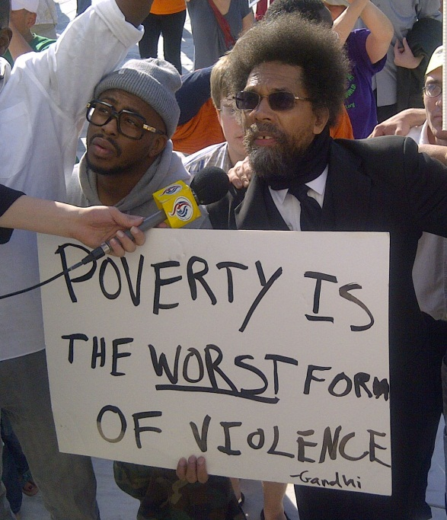
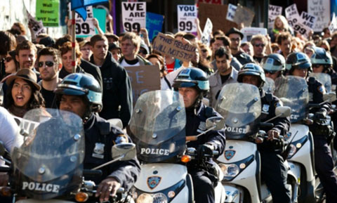
Wealth of poorest 50% v
400 richest families, 2007
Notes:
Leighton, Paul. 2012. The Rich Get Richer and the Poor Get Prison: Inequality, Corporate Power and Crime. Available, http://www.paulsjusticeblog.com/2012/03/inequality_corporate_power_and_crime.php.

Slide 15
Ideology is more efficient to secure an unequal social order than force because it persuades those who have little that the situation is natural, inevitable, just and deserved.
Notes:
Leighton, Paul. 2012. The Rich Get Richer and the Poor Get Prison: Inequality, Corporate Power and Crime. Available, http://www.paulsjusticeblog.com/2012/03/inequality_corporate_power_and_crime.php.

Slide 16
Actual, estimated and ideal distributions of wealth
Top 20% actually control 84% of wealth; people believe they control 59%; ideally, top 20% should control 32%
Bottom 60% actually own 5% of wealth; people believe they control about 20%; ideally, the bottom 60% should control 45% of wealth.
Norton, Michael and Dan Ariely. 2011. Building a Better America. Perspectives on Psychological Science, 6(1): 9-12
Notes:
Leighton, Paul. 2012. The Rich Get Richer and the Poor Get Prison: Inequality, Corporate Power and Crime. Available, http://www.paulsjusticeblog.com/2012/03/inequality_corporate_power_and_crime.php.

Slide 17
Understanding inequality must include the economic and political power of corporate ‘persons’
Notes:
Leighton, Paul. 2012. The Rich Get Richer and the Poor Get Prison: Inequality, Corporate Power and Crime. Available, http://www.paulsjusticeblog.com/2012/03/inequality_corporate_power_and_crime.php.

Slide 18
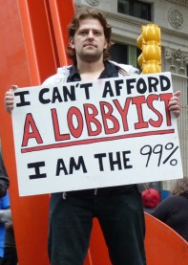
Inequality between real and corporate persons, 2010
International Monetary Fund, World Economic Outlook Database, April 2011. http://www.imf.org
Fortune 500, 2010. http://money.cnn.com/magazines/fortune/fortune500/2010/full_list/.
Notes:
Leighton, Paul. 2012. The Rich Get Richer and the Poor Get Prison: Inequality, Corporate Power and Crime. Available, http://www.paulsjusticeblog.com/2012/03/inequality_corporate_power_and_crime.php.

Slide 19
Country GDP v Corporate Revenue, 2010
Overall Rank | Country Rank | Company Rank | Country/Company | GDP/ Revenue
50 | 48 |  | Pakistan | $ 175
51 |  | 3 | Chevron | $ 164
52 | 49 |  | Romania | $ 162
53 | 50 |  | Algeria | $ 160
54 |  | 4 | General Electric | $ 157
55 | 51 |  | Peru | $ 153
56 |  | 5 | Bank of America Corp. | $ 150
57 | 52 |  | New Zealand | $ 140
58 |  | 6 | ConocoPhillips | $ 140
International Monetary Fund, World Economic Outlook Database, April 2011. http://www.imf.org
Fortune 500, 2010. http://money.cnn.com/magazines/fortune/fortune500/2010/full_list/.
Notes:
Leighton, Paul. 2012. The Rich Get Richer and the Poor Get Prison: Inequality, Corporate Power and Crime. Available, http://www.paulsjusticeblog.com/2012/03/inequality_corporate_power_and_crime.php.

Slide 20
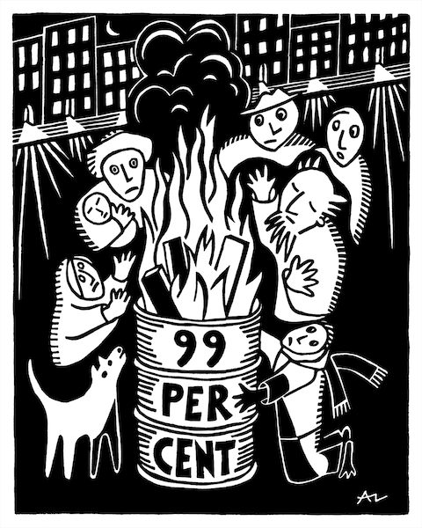
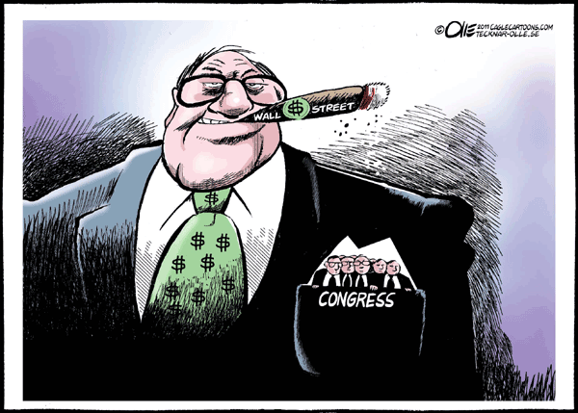
Inequality & Criminology
Inequality worsens both crimes of poverty motivated by need and crimes of wealth motivated by greed
Braithwaite, John. 1992. Poverty Power and White Collar Crime, in Schlegel and Weisburd, White-Collar Crime Reconsidered (Boston: Northeastern University Press).
http://occuprint.org
Notes:
Leighton, Paul. 2012. The Rich Get Richer and the Poor Get Prison: Inequality, Corporate Power and Crime. Available, http://www.paulsjusticeblog.com/2012/03/inequality_corporate_power_and_crime.php.

Slide 21
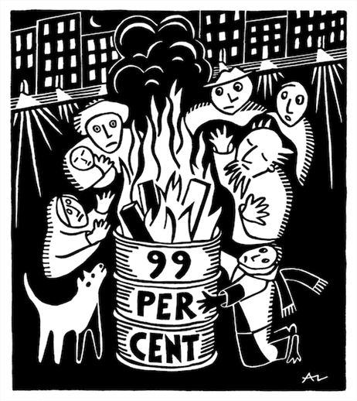
Inequality & crimes of the poor
“Need”: absolute, perceive others to have, what whites have, expectations based on “advertising and dramatization of bourgeois lifestyles” (p 83)
More equal distribution of wealth allows more needs to be met
Fewer legitimate means to success, so more people try illegitimate means
http://occuprint.org
Notes:
Leighton, Paul. 2012. The Rich Get Richer and the Poor Get Prison: Inequality, Corporate Power and Crime. Available, http://www.paulsjusticeblog.com/2012/03/inequality_corporate_power_and_crime.php.

Slide 22
Inequality & Violence I
Jack Katz (1990) Seductions of Crime
Transformation of emotions that result in violence
Righteous Rage
HUMILIATION
[disrespectful disapproval]
VIOLENCE
Guilt, Shame
Notes:
Leighton, Paul. 2012. The Rich Get Richer and the Poor Get Prison: Inequality, Corporate Power and Crime. Available, http://www.paulsjusticeblog.com/2012/03/inequality_corporate_power_and_crime.php.

Slide 23
Inequality & Violence II
Katz + Braithwaite [+ Leighton]
Structural Humiliation
Oppression
[poor in rich society, black in white society]
?
Righteous Rage
HUMILIATION
[disrespectful disapproval]
VIOLENCE
Guilt, Shame
Hegemony
Reduces feelings of exploitation, not ideology enabling exploitation
Notes:
Leighton, Paul. 2012. The Rich Get Richer and the Poor Get Prison: Inequality, Corporate Power and Crime. Available, http://www.paulsjusticeblog.com/2012/03/inequality_corporate_power_and_crime.php.

Slide 24
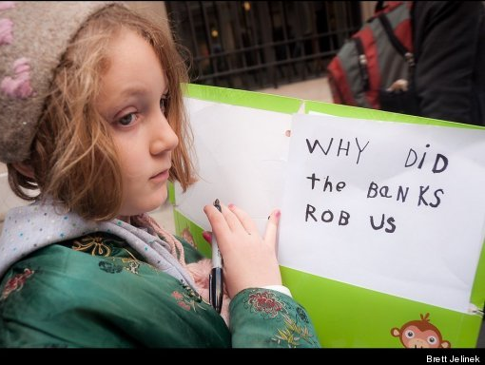
Inequality & crimes of the rich
“increasing concentrations of wealth [enables] the constitution of new forms of illegitimate opportunity” (p 85)
Novel illegitimate strategies that “excel because they cannot be contemplated by those who are not wealthy” (p 88)
“people in positions of power have opportunity to commit crimes that involve the abuse of power, and the more power they have, the more abusive those crimes can be” (p 89)
“undermines respect for the dominion of others” (p 80)
Unaccountable power
Notes:
Leighton, Paul. 2012. The Rich Get Richer and the Poor Get Prison: Inequality, Corporate Power and Crime. Available, http://www.paulsjusticeblog.com/2012/03/inequality_corporate_power_and_crime.php.

Slide 25
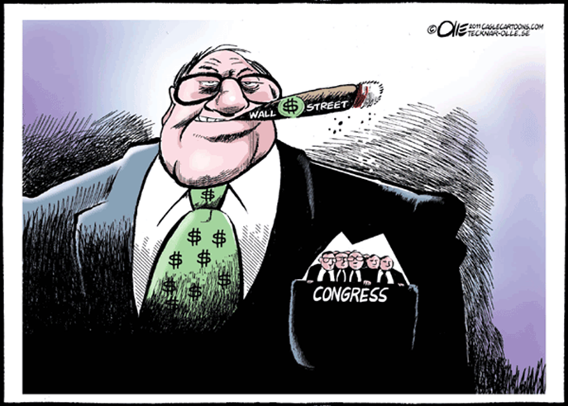
Financial institutions in top 100 largest economies, 2008
Overall rank | Company
58 | Citigroup
63 | Bank of America
66 | JP Morgan Chase
68 | AIG
78 | Goldman Sachs
79 | Morgan Stanley
92 | Merrill Lynch
100 | Lehman Brothers
“power corrupts and unaccountable power corrupts with impunity”
Braithwaite, Poverty Power and White Collar Crime (p 89)
World Bank, Gross Domestic product 2008, http://siteresources.worldbank.org/DATASTATISTICS/Resources/GDP.pdf
Fortune, Fortune 500 for 2008, http://money.cnn.com/magazines/fortune/fortune500/2008/full_list/
Notes:
Leighton, Paul. 2012. The Rich Get Richer and the Poor Get Prison: Inequality, Corporate Power and Crime. Available, http://www.paulsjusticeblog.com/2012/03/inequality_corporate_power_and_crime.php.
Banks and securities firms spent $193 million to fund political campaigns for the 2008 elections and raise even more money through events that their trade groups organize.
In Ritholtz, Is Consumer protection ‘Too Big to Fail’?
http://www.ritholtz.com/blog/2009/11/is-consumer-protection-regulation-too-big-to-fail/

Slide 26
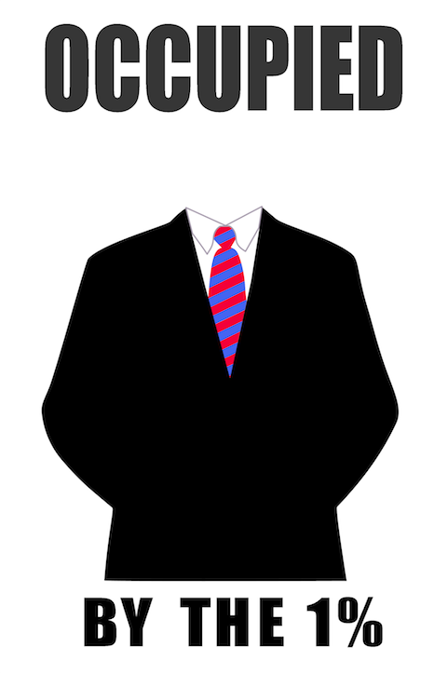
Fines sound large, but…
Goldman Sachs settled a 2010 SEC suit for $550 million for misleading investors.
The government earlier gave Goldman $12.9 billion as a counter-party to AIG, which was rescued with taxpayer $$$
In the year of the SEC settlement, Goldman had revenue of $39 billion and posted profits of $8.35 billion, even after paying the half-billion dollar SEC fine.
http://occuprint.org
Walsh, Mary Williams. 2009. A.I.G. Lists Banks It Paid With U.S. Bailout Funds. New York Times, March 15. http://www.nytimes.com/2009/03/16/business/16rescue.html. See also Taibbi, Matt. 2011. The People vs. Goldman Sachs. Rolling Stone, May 11. http://www.rollingstone.com/politics/news/the-people-vs-goldman-sachs-20110511.
Goldman Sachs. 2011. Form 10-K (Annual Report) filed with the Securities and Exchange Commission, p. 37. http://www2.goldmansachs.com/investor-relations/financials/current/10k/2010-10-k.pdf.
Notes:
Leighton, Paul. 2012. The Rich Get Richer and the Poor Get Prison: Inequality, Corporate Power and Crime. Available, http://www.paulsjusticeblog.com/2012/03/inequality_corporate_power_and_crime.php.
"You put Lloyd Blankfein in pound-me-in-the-ass prison for one six-month term, and all this bullshit would stop, all over Wall Street," says a former congressional aide. Read more: http://www.rollingstone.com/politics/news/why-isnt-wall-street-in-jail-20110216

Slide 27
Inequality, Corporate Dominion & Crime: the case of GE
GE = 54th largest economy in the world
GE has been found guilty of price-fixing, discrimination, illegal procurement of classified documents, felony fraud, retaliation against whistleblowers, lobbied to weaken whistleblower laws, environmental pollution, fought Superfund law, etc.
In 2011, charged with misrepresentation of $549 million in mortgage-backed securities
It owns NBC Universal and other media
http://occuprint.org
Barak, Gregg, Paul Leighton and Jeanne Flavin. 2010. Class, Race, Gender and Crime (Rowman and Littlefield), p 191-3. Federal Housing Finance Authority. 2011. Complaint. http://www.fhfa.gov/webfiles/22602/GE%20Complaint%20Final.pdf.
Notes:
Leighton, Paul. 2012. The Rich Get Richer and the Poor Get Prison: Inequality, Corporate Power and Crime. Available, http://www.paulsjusticeblog.com/2012/03/inequality_corporate_power_and_crime.php.

Slide 28
GE’s media ownership
GE
1985-2011 = 85% ownership, 2011 = 49% ownership
NBC Universal
NBC
Nightly News, Meet the Press, 30 Rock
MSNBC
CNBC
(financial news)
USA
White Collar
Notes:
Leighton, Paul. 2012. The Rich Get Richer and the Poor Get Prison: Inequality, Corporate Power and Crime. Available, http://www.paulsjusticeblog.com/2012/03/inequality_corporate_power_and_crime.php.

Slide 29
2010 GE reported US profits of $5.1 billion, paid no taxes and claimed a credit of $3.2 billion
Notes:
Leighton, Paul. 2012. The Rich Get Richer and the Poor Get Prison: Inequality, Corporate Power and Crime. Available, http://www.paulsjusticeblog.com/2012/03/inequality_corporate_power_and_crime.php.

Slide 30
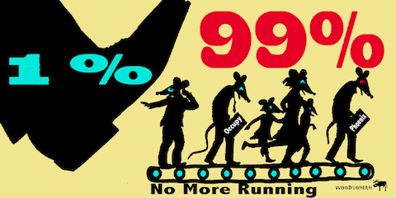
GE owns USA network, so White Collar presents narrow apolitical examples
What's missing is what Quinney describes as crimes of domination
‘crimes of control’ by police in violation of civil liberties
‘crimes of government’ like Watergate, Iran-Contragate, or torturing suspected terrorists
http://occuprint.org
‘crimes of economic domination’ corporate acts like price-fixing, pollution, unsafe workplaces and products
‘crimes’ of ‘social injury’’ legal or illegal denial of human rights, (racism, sexism, and economic exploitation)
Notes:
Leighton, Paul. 2012. The Rich Get Richer and the Poor Get Prison: Inequality, Corporate Power and Crime. Available, http://www.paulsjusticeblog.com/2012/03/inequality_corporate_power_and_crime.php.

Slide 31
White Collar v “Ripped from the Headlines” mortgage fraud
White Collar: individual judge forging signature on documents
Ripped from the Headlines
fraud and abuse of power by financial institutions;
misrepresentations in securitized mortgage products;
high executive pay and bonuses for those who drove the companies into bankruptcy and economy into crisis;
assault on private property rights by institutions that cheaply hire “robosigners” to file foreclosure affidavits swearing to facts they do not know;
a system where meaningful financial reform is shaped by “Republican harlots, who seem to have never met a corporate phallus they could not find new and clever ways to debase themselves to” and “Democrat trollops, who have tried to out-GOP the GOP as fellatrix in search of campaign contributions” (Ritholtz, Barry. 2011. Jezebels undermining financial overhaul. [May 13], http://www.ritholtz.com/blog/2011/05/jezebels-undermining-financial-overhaul/.)
Notes:
Leighton, Paul. 2012. The Rich Get Richer and the Poor Get Prison: Inequality, Corporate Power and Crime. Available, http://www.paulsjusticeblog.com/2012/03/inequality_corporate_power_and_crime.php.

Slide 32
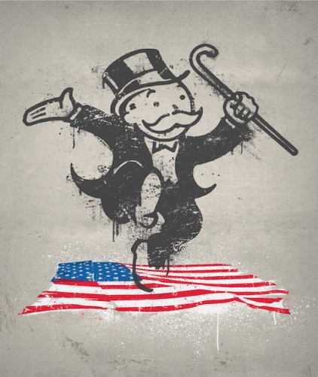
Limits of discourse on corporate crime in the corporate media
SATIRE has a corrective purpose and critical mode - aims at “a public Spirit, prompting Men of Genius and Virtue, to mend the World as far as they are able” (Swift)
Criticism in satire is directed at “a world of hypocrisy, in which lip service to morals are used to hide evils … the satirist sneers at the knavish dissimulators through his irony both to expose them and to give them affront; irony serves to expose the villain so that the audience can shun him, and to make the villain squirm so that he may mend his actions.”
Notes:
Leighton, Paul. 2012. The Rich Get Richer and the Poor Get Prison: Inequality, Corporate Power and Crime. Available, http://www.paulsjusticeblog.com/2012/03/inequality_corporate_power_and_crime.php.

Slide 33
Limits of discourse on corporate crime in the corporate media
30 Rock
Liz: Big business is what’s screwing up this country.
Jack: Please, Lemon, you work for General Electric!
30 Rock “therefore, acts as a means by which GE can both control and redefine the public’s perception and criticism of the company” (Harvey 2011).
Ripped from the headlines
“Yes, big business makes millions, lays off workers, pays no taxes and the CEO becomes an economic adviser to President Obama.”
[If that doesn’t sound funny, see Jon Stewart’s “I give Up” opening to the Daily Show 28 March 2011 – google “Daily Show GE pays no taxes”]
Notes:
Leighton, Paul. 2012. The Rich Get Richer and the Poor Get Prison: Inequality, Corporate Power and Crime. Available, http://www.paulsjusticeblog.com/2012/03/inequality_corporate_power_and_crime.php.

Slide 34
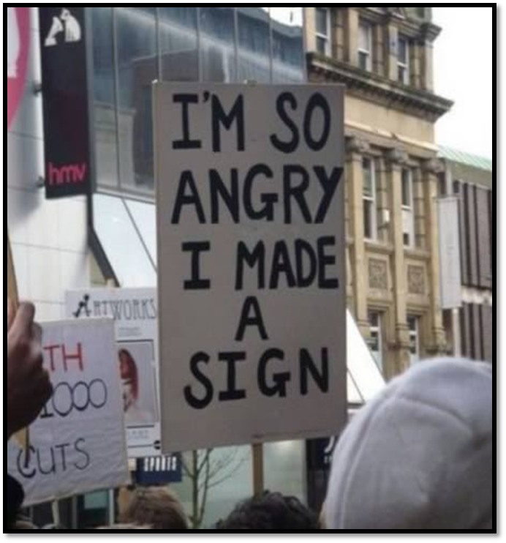
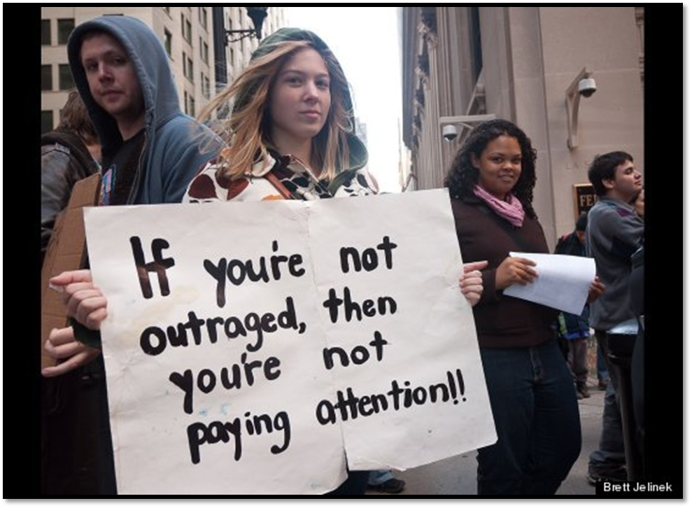
Conclusions
Notes:
Leighton, Paul. 2012. The Rich Get Richer and the Poor Get Prison: Inequality, Corporate Power and Crime. Available, http://www.paulsjusticeblog.com/2012/03/inequality_corporate_power_and_crime.php.

Slide 35
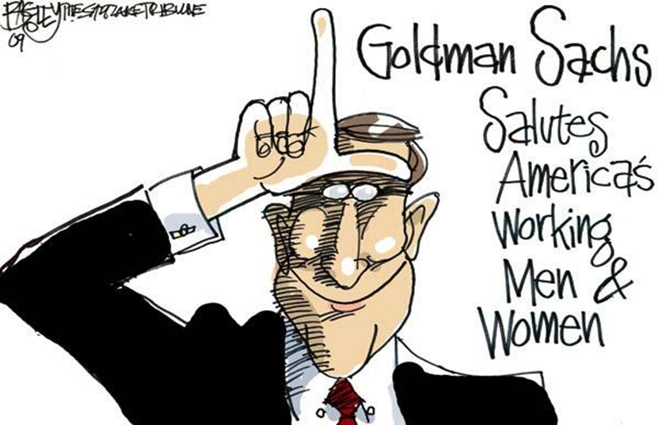
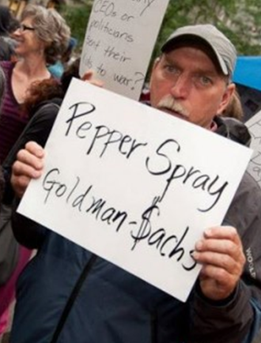
I More inequality than you realize
“to claim to be apolitical or neutral in the face of such injustices would be, in actuality, to uphold the status quo – a very political position to take and on the side of the oppressors” -Sister Helen Prejean, Dead Man Walking
Notes:
Leighton, Paul. 2012. The Rich Get Richer and the Poor Get Prison: Inequality, Corporate Power and Crime. Available, http://www.paulsjusticeblog.com/2012/03/inequality_corporate_power_and_crime.php.

Slide 36
II Redistribution reduces crime
“If crime in the suites arises from the fact that certain people have great wealth and power, and if crime in the suites arises from the fact that certain other people have very little wealth or power, then policies to redistribute wealth and power may simultaneously relieve both types of crime” (Braithwaite, p 90)
http://occuprint.org
Notes:
Leighton, Paul. 2012. The Rich Get Richer and the Poor Get Prison: Inequality, Corporate Power and Crime. Available, http://www.paulsjusticeblog.com/2012/03/inequality_corporate_power_and_crime.php.

Slide 37
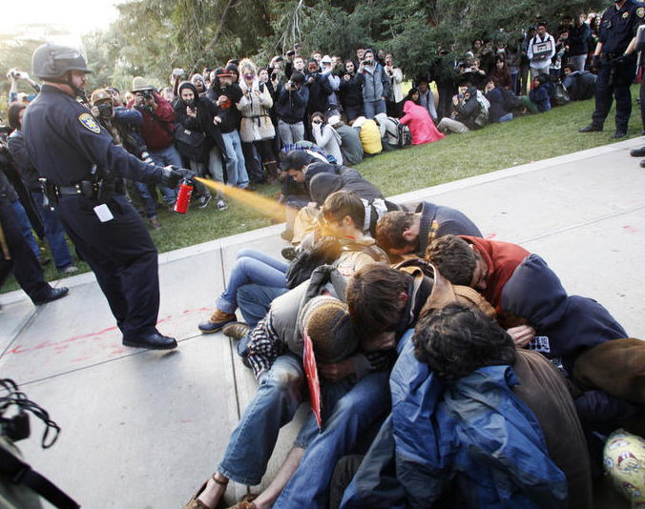
III Rule of Law increasingly broken
"Everything's fucked up, and nobody goes to jail"
Peaceful protesters get arrested for disorderly conduct, while those who created serious disorder with the world economy keep getting bonuses and go about business as usual. Financial crooks lobby against reform legislation and consumer financial protection.
http://occuprint.org
Taibbi, Matt 2011. Why Isn't Wall Street in Jail? Rolling Stone, Feb 16. http://www.rollingstone.com/politics/news/why-isnt-wall-street-in-jail-20110216 Reiman, Jeffrey and Paul Leighton. 2013. The Rich Get Richer and the Poor Get Prison, 10th ed. Boston: Allyn & Bacon (forthcoming)
Notes:
Leighton, Paul. 2012. The Rich Get Richer and the Poor Get Prison: Inequality, Corporate Power and Crime. Available, http://www.paulsjusticeblog.com/2012/03/inequality_corporate_power_and_crime.php.

Slide 38
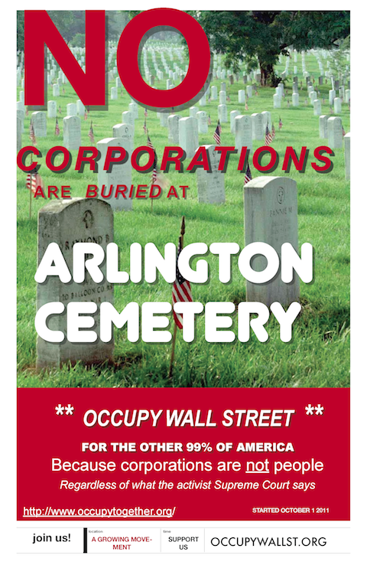
IV Corporations have more power and less conscience than you realize
http://occuprint.org/
Notes:
Leighton, Paul. 2012. The Rich Get Richer and the Poor Get Prison: Inequality, Corporate Power and Crime. Available, http://www.paulsjusticeblog.com/2012/03/inequality_corporate_power_and_crime.php.

Slide 39
http://occuprint.org
Notes:
Leighton, Paul. 2012. The Rich Get Richer and the Poor Get Prison: Inequality, Corporate Power and Crime. Available, http://www.paulsjusticeblog.com/2012/03/inequality_corporate_power_and_crime.php.

Slide 40
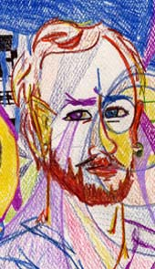
Dr. Paul Leighton is a professor in the Department of Sociology, Anthropology & Criminology at Eastern Michigan University.
More information about him is available on his website,
http://paulsjusticepage.com/paul/pauls-cv.htm
I believe and hope my use of the images in this presentation
is covered by ‘fair use.’ Requests to remove materials should
be sent to the presenter through his address on this page
http://paulsjusticepage.com/paul.htm

