Slide 1
Criminology needs more class: Inequality, corporate persons and an impoverished discipline
Paul Leighton
American Society of Criminology, 2012
Notes:
Leighton, Paul. 2013. Criminology Needs More Class; Inequality, Corporate Persons and an Impoverished Discipline. Available, http://www.paulsjusticeblog.com/2012/11/criminology_needs_more_class.php.

Slide 2
This presentation is adapted from a longer invited lecture,
The Rich Get Richer and the Poor Get Prison: Inequality, Corporate Power and Crime
Available PaulsJusticeBlog.com
The creators of any graphics used in this presentation who want attribution or removal should contact me through my website, http://paulsjusticepage.com.
For more about this presentation, see
http://www.paulsjusticeblog.com/2012/11/criminology_needs_more_class.php.
Notes:
Leighton, Paul. 2013. Criminology Needs More Class; Inequality, Corporate Persons and an Impoverished Discipline. Available, http://www.paulsjusticeblog.com/2012/11/criminology_needs_more_class.php.

Slide 3
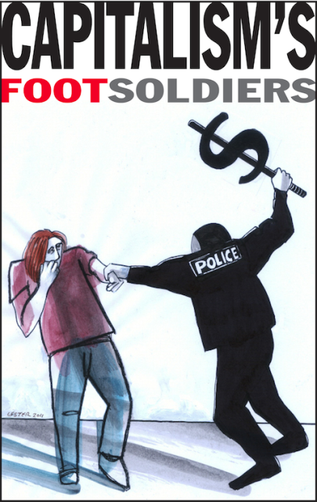
Class, Race & Gender are the ‘holy trinity,’ but social analysis and criminology are effectively ‘de-classed’
“the scale of this inequality is almost beyond comprehension, perhaps not surprisingly as much of it remains hidden from view” (Mooney 2008: 64).
Class important because
CJ can be no more fair than the society for which it provides ‘law and order’ - reflect and recreate injustices in social order
Without attention to white collar and corporate crime, we have the wrong pictures of harms that threaten us and do not pursue policies to advance public safety
‘Equality under law’ requires assessment of class bias in CJ
Inequality shapes patterns of offending in ways theory and policy need to understand
http://occuprint.org/
Mooney, G. (2008) ‘Explaining poverty, social exclusion and inequality’ in T. Ridge and S. Wright (eds) Understanding Inequality, Poverty and Wealth, Bristol (U.K.): Policy Press.
Notes:
Leighton, Paul. 2013. Criminology Needs More Class; Inequality, Corporate Persons and an Impoverished Discipline. Available, http://www.paulsjusticeblog.com/2012/11/criminology_needs_more_class.php.

Slide 4
Roadmap
Inequality
Income
Wealth
Corporate ‘persons’ and inequality
Criminology
Inequality and street crime
Inequality and corporate crime
Conclusion
http://occuprint.org/
Notes:
Leighton, Paul. 2013. Criminology Needs More Class; Inequality, Corporate Persons and an Impoverished Discipline. Available, http://www.paulsjusticeblog.com/2012/11/criminology_needs_more_class.php.

Slide 5
Class: “What explains how people locate themselves and others in a structure of inequality?”
class = a hand of cards, with the suits representing
Education
Income
Occupation
Wealth
Wright, Erik Olin, 1997. Class Counts. Cambridge: Cambridge University Press.
Scott, Janny, and David Leonhardt. 2005. “Class in America: Shadowy Lines That Still Divide.” New York Times, May 15.
Notes:
Leighton, Paul. 2013. Criminology Needs More Class; Inequality, Corporate Persons and an Impoverished Discipline. Available, http://www.paulsjusticeblog.com/2012/11/criminology_needs_more_class.php.

Slide 6
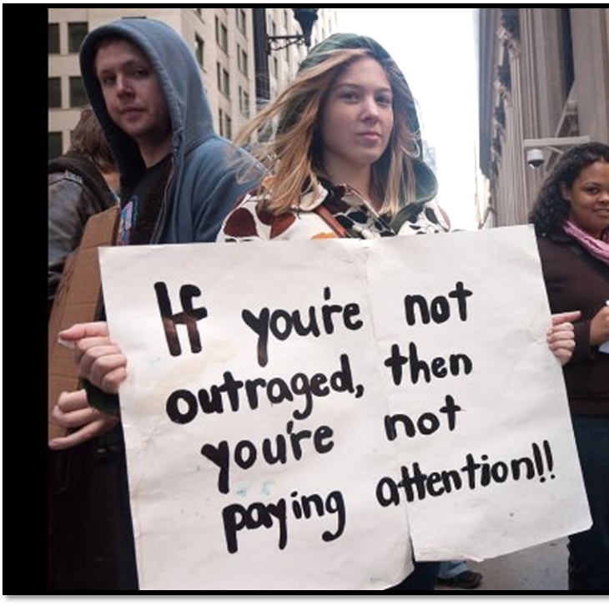
Income Overview
INCOME = SALARY
For richer, it includes interest and
dividends (not capital gains in
Census data)
Median household income
was $49,445 in 2010
Official poverty rate = 15.1% (22% for children)
46.2 million people = largest number in the 52 years for which poverty estimates have been published
DeNavas-Walt, Carmen, Bernadette D. Proctor, and Jessica C. Smith, U.S. Census Bureau, Current Population Reports, P60-239, Income, Poverty, and Health Insurance Coverage in the United States: 2010, U.S. Government Printing Office, Washington, DC,2011. http://www.census.gov/hhes/www/income/income.html.
Notes:
Leighton, Paul. 2013. Criminology Needs More Class; Inequality, Corporate Persons and an Impoverished Discipline. Available, http://www.paulsjusticeblog.com/2012/11/criminology_needs_more_class.php.

Slide 7
Income Privilege
Both high and low income tend to spend much of what they make, so you can still be “rich” and have class privilege if you have $0 at the end of the month.
Consider:
I can buy things for my comfort
I do not fear being hungry or homeless
I have the time and money to take care of my body
I do not worry about my access to medical care
I have the freedom to be unaware of the working conditions of others
I do not need public transportation
Pease, Bob. 2010. Undoing Privilege (Zed Books)
Notes:
Leighton, Paul. 2013. Criminology Needs More Class; Inequality, Corporate Persons and an Impoverished Discipline. Available, http://www.paulsjusticeblog.com/2012/11/criminology_needs_more_class.php.

Slide 8
Income Distribution, 2010
Households | Share of Aggregate Income | Upper Limit (You are in this group if you make less than…)
Lowest Fifth | 3.3% | $20,000
Second Fifth | 8.5% | $38,043
Third Fifth | 14.6% | $61,735
Fourth Fifth | 23.4% | $100,065
Highest Fifth | 50.2%
Top 5% | 21.3% | Lower limit = $180,810
Hedge fund managers
John Paulson: $4.9 billion
Ray Dalio $3.1 billion
U.S. Census Bureau, Current Population Survey, Annual Social and Economic Supplements, Tables H-1 and H-2
http://www.census.gov/hhes/www/income/data/historical/household/
2010 Highest Paid hedge-Fund Managers (2011) http://www.therichest.org/business/highest-paid-hedge-fund-managers-2010/
Notes:
Leighton, Paul. 2013. Criminology Needs More Class; Inequality, Corporate Persons and an Impoverished Discipline. Available, http://www.paulsjusticeblog.com/2012/11/criminology_needs_more_class.php.

Slide 9
Income Inequality Over Time
CNN. 2011. How the middle class became the underclass http://money.cnn.com/2011/02/16/news/economy/middle_class/index.htm?iid=MPM
For data used to build graph, see Emmanual Saez’s webpage, http://elsa.berkeley.edu/~saez/.
Notes:
Leighton, Paul. 2013. Criminology Needs More Class; Inequality, Corporate Persons and an Impoverished Discipline. Available, http://www.paulsjusticeblog.com/2012/11/criminology_needs_more_class.php.

Slide 10
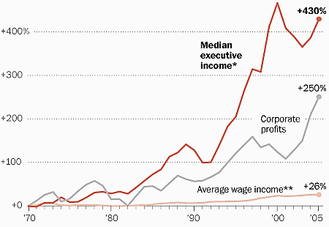
Income Inequality: Executive Pay
* Based on the salary, bonuses and stock options of the three highest-paid officers in the largest 50 firms.
** Calculated from Bureau of Economic Analysis data.
NOTE: All figures have been adjusted for inflation.
It’s NOT ‘pay for performance when executive pay rises faster than corporate profits.
Repeated surveys “since 1987 have found that 60 percent or more of Americans agree or strongly agree with the statement that ‘differences in income in America are too large.’”
Whoriskey, Peter. 2011. With executive pay, rich pull away from rest of America. Washington Post, June 18. http://www.washingtonpost.com/business/economy/with-executive-pay-rich-pull-away-from-rest-of-america/2011/06/13/AGKG9jaH_story.html.
Notes:
Leighton, Paul. 2013. Criminology Needs More Class; Inequality, Corporate Persons and an Impoverished Discipline. Available, http://www.paulsjusticeblog.com/2012/11/criminology_needs_more_class.php.

Slide 11
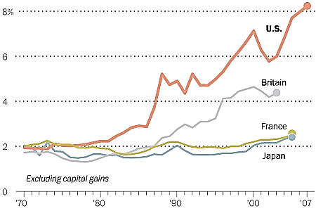
Income Inequality: International Comparisons
Share of income earned by top 0.1%
Washington Post. No date. (NOT) Spreading the Wealth
http://www.washingtonpost.com/wp-srv/special/business/income-inequality/.
Notes:
Leighton, Paul. 2013. Criminology Needs More Class; Inequality, Corporate Persons and an Impoverished Discipline. Available, http://www.paulsjusticeblog.com/2012/11/criminology_needs_more_class.php.

Slide 12
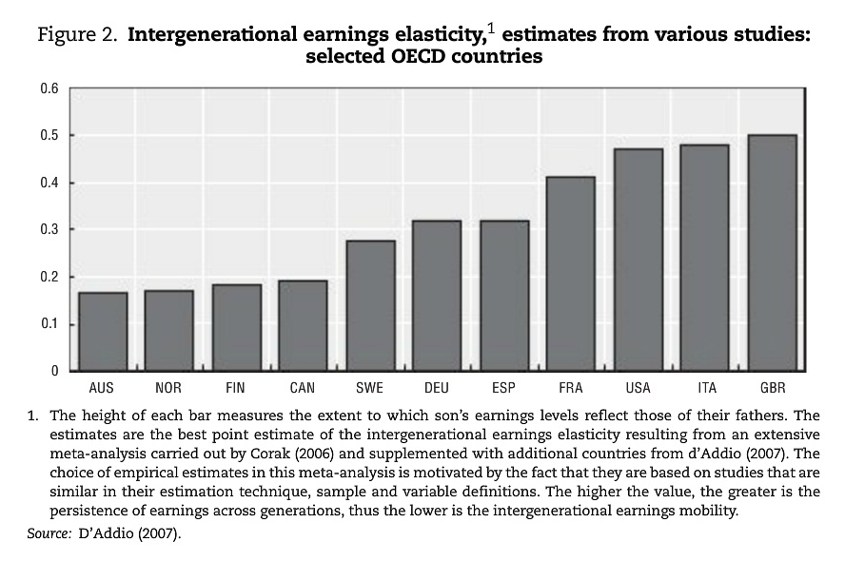
Intergenerational Mobility
Causa, Orsetta and Asa Johansson. 2010. Intergenerational Social
Mobility in OECD Countries.
OECD Journal: Economic
Studies, Volume 2010.
p 3 (quote) and p 9 (chart)
“Low mobility across generations, as measured by a close link between parents’ and children’s earnings, is particularly pronounced in the United Kingdom, Italy, the United States and France, while mobility is higher in the Nordic countries, Australia and Canada.”
Notes:
Leighton, Paul. 2013. Criminology Needs More Class; Inequality, Corporate Persons and an Impoverished Discipline. Available, http://www.paulsjusticeblog.com/2012/11/criminology_needs_more_class.php.

Slide 13
Wealth Overview
Wealth (net worth) = assets – liabilities
Median net worth, 2007 = $120,300
[mean = $556,300]
White, non-Hispanic = $170,400
Nonwhite or Hispanic = $27,800
Bucks, Brian, et al. 2009. Changes in U.S. Family Finances from 2004 to 2007. http://federalreserve.gov/econresdata/scf/files/2007_scf09.pdf (p A11)
Wealth is about
SECURITY and POWER
Notes:
Leighton, Paul. 2013. Criminology Needs More Class; Inequality, Corporate Persons and an Impoverished Discipline. Available, http://www.paulsjusticeblog.com/2012/11/criminology_needs_more_class.php.

Slide 14
Wealth: International Comparison
U.S. (share owned by percentile group) | Percentile group | U.K. (share owned by percentile group)
2.5 | Bottom 50 | 13
26 | 50 to 90 | 42
71.5 | Top 10 | 44
Calculated from Kennickell (2009: 35) and HMRC (2011: Table 13.8). U.K. numbers are based on data from 2005 to 2007.
Notes:
Leighton, Paul. 2013. Criminology Needs More Class; Inequality, Corporate Persons and an Impoverished Discipline. Available, http://www.paulsjusticeblog.com/2012/11/criminology_needs_more_class.php.

Slide 15
Wealth Distribution, 2007
Households | Share of Aggregate Income | Notes
Bottom 50% | 2.5% | At 10th Percentile, wealth = $0
50 – 90th percentile | 26% | Upper limit of 75th percentile = $372,000 90th percentile = $908,200
90 – 95th percentile | 11.1%
95 – 99th percentile | 26.6%
99 – 100th percentile | 33.8% | Own 52% of stock and 63% of equity in private business
Top percentile does not include Forbes 400 (min = $1.3 billion, max = $59 billion)
Kennickell, Arthur. 2009. Ponds and Streams: Wealth and Income in the U.S., 1989 to 2007.
http://www.federalreserve.gov/pubs/feds/2009/200913/200913pap.pdf. Table 2, 4, A1, A3a
Notes:
Leighton, Paul. 2013. Criminology Needs More Class; Inequality, Corporate Persons and an Impoverished Discipline. Available, http://www.paulsjusticeblog.com/2012/11/criminology_needs_more_class.php.

Slide 16
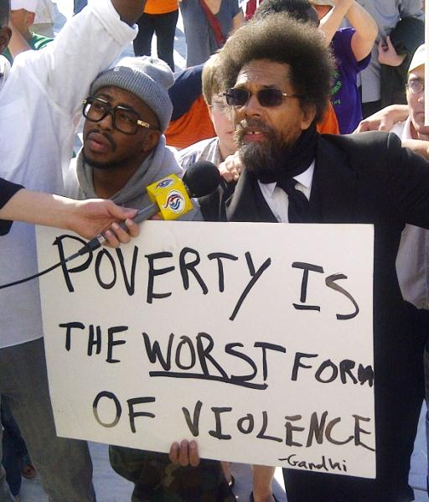
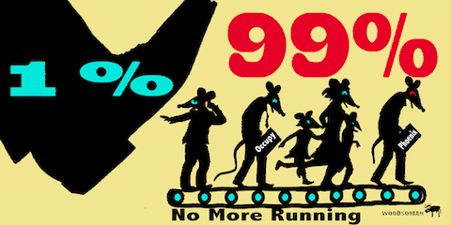
Wealth of poorest 50% v
400 richest families, 2007
http://occuprint.org/
Notes:
Leighton, Paul. 2013. Criminology Needs More Class; Inequality, Corporate Persons and an Impoverished Discipline. Available, http://www.paulsjusticeblog.com/2012/11/criminology_needs_more_class.php.

Slide 17
Actual, estimated and ideal distributions of wealth
Top 20% actually control 84% of wealth; people believe they control 59%; ideally, top 20% should control 32%
Bottom 60% actually own 5% of wealth; people believe they control about 20%; ideally, the bottom 60% should control 45% of wealth.
Norton, Michael and Dan Ariely. 2011. Building a Better America. Perspectives on Psychological Science, 6(1): 9-12
Notes:
Leighton, Paul. 2013. Criminology Needs More Class; Inequality, Corporate Persons and an Impoverished Discipline. Available, http://www.paulsjusticeblog.com/2012/11/criminology_needs_more_class.php.

Slide 18
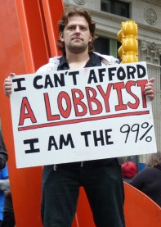
Inequality between real and corporate persons, 2010
International Monetary Fund, World Economic Outlook Database, April 2011. http://www.imf.org
Fortune 500, 2010. http://money.cnn.com/magazines/fortune/fortune500/2010/full_list/.
Notes:
Leighton, Paul. 2013. Criminology Needs More Class; Inequality, Corporate Persons and an Impoverished Discipline. Available, http://www.paulsjusticeblog.com/2012/11/criminology_needs_more_class.php.

Slide 19
Country GDP v Corporate Revenue, 2010
Overall Rank | Country Rank | Company Rank | Country/Company | GDP/ Revenue*
1 | 1 |  | United States | $15,065
29 | 29 |  | South Africa | $560
30 |  | 1 | Wal-Mart | $422
32 |  | 2 | Exxon-Mobil | $354
62 |  | 6 | General Electric | $152
66 |  | 9 | Bank of America | $134
70 | 58 |  | Vietnam | $121
71 |  | 13 | J.P. Morgan Chase | $116
73 |  | 14 | Citigroup | $111
86 |  | 23 | Wells Fargo | $93
Fortune 500 from http://money.cnn.com/magazines/fortune/fortune500/2011/full_list/ . International Monetary Fund, World Economic Outlook Database, September 2011. Gross domestic product is expressed in current (2011) U.S. dollars. http://www.imf.org/external/pubs/ft/weo/2011/02/weodata/index.aspx.
* In billions of US dollars
Notes:
Leighton, Paul. 2013. Criminology Needs More Class; Inequality, Corporate Persons and an Impoverished Discipline. Available, http://www.paulsjusticeblog.com/2012/11/criminology_needs_more_class.php.

Slide 20
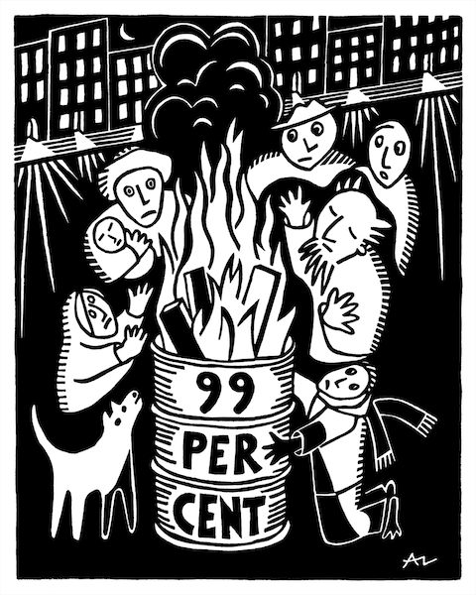
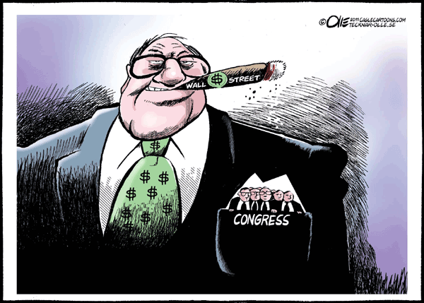
Inequality & Criminology
Inequality worsens both crimes of poverty motivated by need and crimes of wealth motivated by greed
Braithwaite, John. 1992. Poverty Power and White Collar Crime, in Schlegel and Weisburd, White-Collar Crime Reconsidered (Boston: Northeastern University Press).
http://occuprint.org
Notes:
Leighton, Paul. 2013. Criminology Needs More Class; Inequality, Corporate Persons and an Impoverished Discipline. Available, http://www.paulsjusticeblog.com/2012/11/criminology_needs_more_class.php.

Slide 21
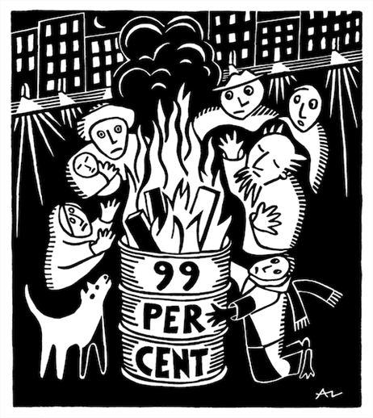
Inequality & crimes of the poor
“Need”: absolute, perceive others to have, what whites have, expectations based on “advertising and dramatization of bourgeois lifestyles” (Braithwaite 1992 p 83)
Fewer legitimate means to success, so more people try illegitimate means
http://occuprint.org
Notes:
Leighton, Paul. 2013. Criminology Needs More Class; Inequality, Corporate Persons and an Impoverished Discipline. Available, http://www.paulsjusticeblog.com/2012/11/criminology_needs_more_class.php.

Slide 22
Inequality & Violence I
Jack Katz (1990) Seductions of Crime
Transformation of emotions that result in violence
Righteous Rage
HUMILIATION
[disrespectful disapproval]
VIOLENCE
Guilt, Shame
Notes:
Leighton, Paul. 2013. Criminology Needs More Class; Inequality, Corporate Persons and an Impoverished Discipline. Available, http://www.paulsjusticeblog.com/2012/11/criminology_needs_more_class.php.

Slide 23
Inequality & Violence II
Katz + Braithwaite [+ Quinney 1977]
Structural Humiliation
Oppression
[poor in rich society, black in white society]
?
Righteous Rage
HUMILIATION
[disrespectful disapproval]
VIOLENCE
Guilt, Shame
Hegemony
Reduces feelings of exploitation
Notes:
Leighton, Paul. 2013. Criminology Needs More Class; Inequality, Corporate Persons and an Impoverished Discipline. Available, http://www.paulsjusticeblog.com/2012/11/criminology_needs_more_class.php.

Slide 24
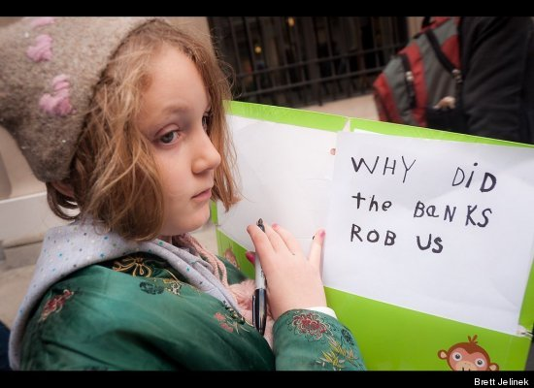
Inequality & crimes of the rich
“increasing concentrations of wealth [enables] the constitution of new forms of illegitimate opportunity” (p 85)
Novel illegitimate strategies that “excel because they cannot be contemplated by those who are not wealthy” (p 88)
“people in positions of power have opportunity to commit crimes that involve the abuse of power, and the more power they have, the more abusive those crimes can be” (p 89)
“undermines respect for the dominion of others” (p 80)
“power corrupts and unaccountable power corrupts with impunity” (p 89)
All quotes from Braithwaite 1992
Notes:
Leighton, Paul. 2013. Criminology Needs More Class; Inequality, Corporate Persons and an Impoverished Discipline. Available, http://www.paulsjusticeblog.com/2012/11/criminology_needs_more_class.php.

Slide 25
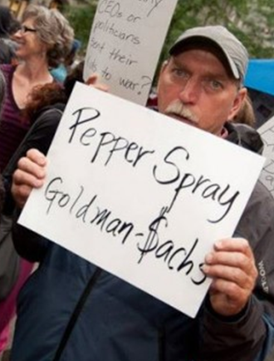
Conclusion I: More inequality than you realize
“to claim to be apolitical or neutral in the face of such injustices would be, in actuality, to uphold the status quo – a very political position to take and on the side of the oppressors” -Sister Helen Prejean, Dead Man Walking
Notes:
Leighton, Paul. 2013. Criminology Needs More Class; Inequality, Corporate Persons and an Impoverished Discipline. Available, http://www.paulsjusticeblog.com/2012/11/criminology_needs_more_class.php.

Slide 26
Conclusion II: Corporations have more power and less conscience than you realize
http://occuprint.org/
Notes:
Leighton, Paul. 2013. Criminology Needs More Class; Inequality, Corporate Persons and an Impoverished Discipline. Available, http://www.paulsjusticeblog.com/2012/11/criminology_needs_more_class.php.

Slide 27
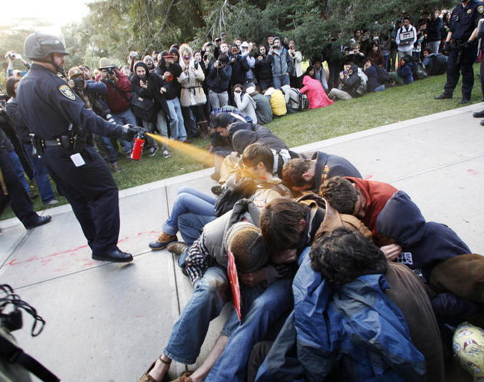
Conclusion III: Rule of Law increasingly broken
"Everything's fucked up, and nobody goes to jail"
Peaceful protesters get arrested for disorderly conduct, while those who created serious disorder with the world economy keep getting bonuses and go about business as usual. Financial crooks lobby against reform legislation and consumer financial protection.
http://occuprint.org
Taibbi, Matt 2011. Why Isn't Wall Street in Jail? Rolling Stone, Feb 16. http://www.rollingstone.com/politics/news/why-isnt-wall-street-in-jail-20110216 Reiman, Jeffrey and Paul Leighton. 2013. The Rich Get Richer and the Poor Get Prison, 10th ed. Boston: Allyn & Bacon (forthcoming)
Notes:
Leighton, Paul. 2013. Criminology Needs More Class; Inequality, Corporate Persons and an Impoverished Discipline. Available, http://www.paulsjusticeblog.com/2012/11/criminology_needs_more_class.php.

Slide 28
Conclusion IV: Official “crime” rates do not reflect reality
During the collapse of Enron and other companies in 2001 – when accounting fraud cost investors 70 to 90 percent of their money and top officials of those companies “were getting immensely, extraordinarily, obscenely wealthy” (in Reiman and Leighton 2013: 146) – the Department of Justice reported that “property crimes had continued their downward trend and fallen to an all-time low” (in Barak 2012: 73).
http://occuprint.org
Reiman, Jeffrey and Paul Leighton. 2013. The Rich Get Richer & the Poor Get Prison, 10th ed. Boston: Allyn & Bacon/Pearson.
Barak, Gregg.2012. Theft of a Nation. Lanham: Rowman & Littlefield.
Notes:
Leighton, Paul. 2013. Criminology Needs More Class; Inequality, Corporate Persons and an Impoverished Discipline. Available, http://www.paulsjusticeblog.com/2012/11/criminology_needs_more_class.php.

Slide 29
Conclusion V: Redistribution reduces crime
“If crime in the suites arises from the fact that certain people have great wealth and power, and if crime in the streets arises from the fact that certain other people have very little wealth or power, then policies to redistribute wealth and power may simultaneously relieve both types of crime” (Braithwaite, 1992 p 90)
http://occuprint.org
Notes:
Leighton, Paul. 2013. Criminology Needs More Class; Inequality, Corporate Persons and an Impoverished Discipline. Available, http://www.paulsjusticeblog.com/2012/11/criminology_needs_more_class.php.

Slide 30
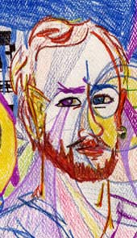
Dr. Paul Leighton is a professor in the Department of Sociology, Anthropology & Criminology at Eastern Michigan University.
More information about him is available on his website,
http://paulsjusticepage.com/paul/pauls-cv.htm
I believe and hope my use of the images in this presentation
is covered by ‘fair use.’ Requests to remove materials should
be sent to the presenter through his address on this page
http://paulsjusticepage.com/paul.htm
Notes:
Leighton, Paul. 2013. Criminology Needs More Class; Inequality, Corporate Persons and an Impoverished Discipline. Available, http://www.paulsjusticeblog.com/2012/11/criminology_needs_more_class.php.

